Slide 1
What’s in a name?
When two people use different names for the same thing, misunderstood words are apt to happen.
The British and Americans often get confused!

Slide 2
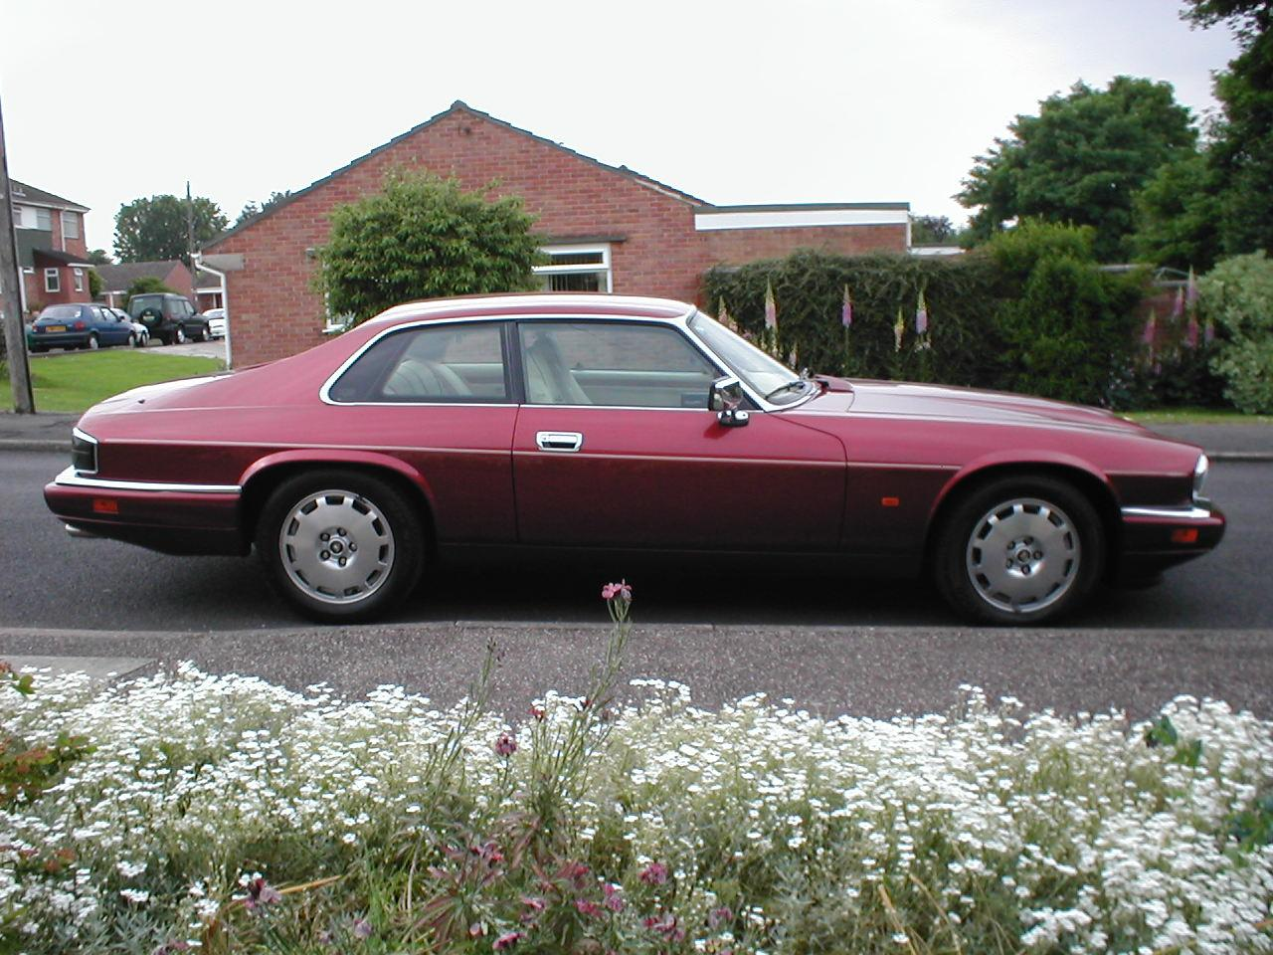
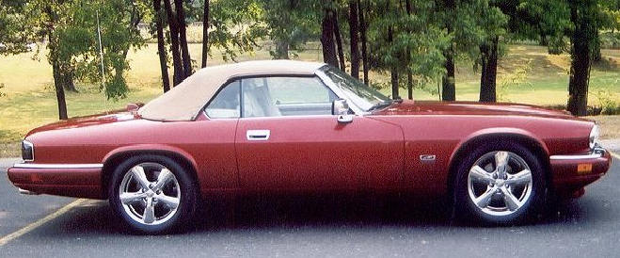
Find the bonnet. Find the boot.

Slide 3
Chemical Nomenclature!
Systematic way to name chemical compounds!
Now you will be looking at labels differently!

Slide 4
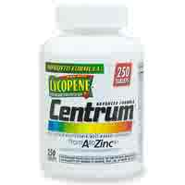
Centrum Multi-Vitamin
Ingredients: ascorbic acid, beta carotene, biotin, calcium pantothenate, calcium
phosphate, carnauba wax, chromium chloride, crospovidone, cupric sulfate,
cyanocobalamin, dl-alpha tocopheryl acetate, FD & C blue no. 2 aluminum lake,
hydroxypropyl cellulose, ferrous fumarate, hydroxypropyl methylcellulose, lactose,
Magnesium oxide, magnesium stearate, manganese sulfate, microcrystalline cellu-
lose,niacinamide, nickel sulfate, phytonandione, polyethylene glycol, potassium
chloride, potassium citrate, potassium iodide, povidone, pyridoxine hydrochloride,
riboflavin, silica gel, sodium borate, sodium metavanadate, sodium molybdate,
sodium selenate, stannous chloride, stearic acid, thiamin mononitrate, titanium
dioxide, triacetin, vitamin A acetate, vitamin D₃, zinc oxide. PC7563-46-00
Warning: Accidental overdose of iron-containing products is a leading cause of
fatal poisoning in children under 6. Keep this product out of reach of children.
In case of accidental overdose, call a doctor or poison control immediately.

Slide 5
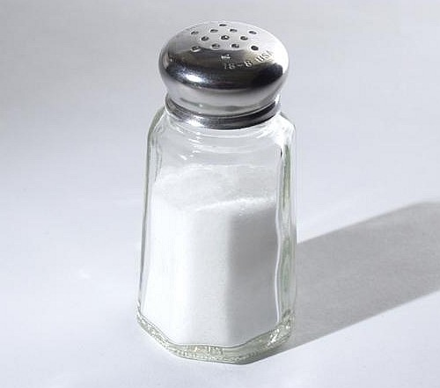
Type ONE
Simple Binary Compounds
Only Two Elements
Monovalent metal and a non-metal
State metal then non-metal change ending to ide

Slide 6
Binary Compounds
1+
1
H
1
2+
3+
He
2
2
Li
3
Be
4
B
5
C
6
N
7
O
8
F
9
Ne
10
3
Na
11
Mg
12
1+
2+
Al
13
Si
14
P
15
S
16
Cl
17
Ar
18
4
K
19
Ca
20
Sc
21
Ti
22
V
23
Cr
24
Mn
25
Fe
26
Co
27
Ni
28
Cu
29
Zn
30
Ga
31
Ge
32
As
33
Se
34
Br
35
Kr
36
Binary compounds that contain a metal of fixed oxidation number
(group 1, group 2, Al, Zn, Ag, etc.), and a non-metal.
Rb
37
Sr
38
Y
39
Zr
40
Nb
41
Mo
42
Tc
43
Ru
44
Rh
45
Pd
46
Ag
47
Cd
48
In
49
Sn
50
Sb
51
Te
52
I
53
Xe
54
5
6
Cs
55
Ba
56
∗
Hf
72
Ta
73
W
74
Re
75
Os
76
Ir
77
Pt
78
Au
79
Hg
80
Tl
81
Pb
82
Bi
83
Po
84
At
85
Rn
86
7
Fr
87
Ra
88
Ω
Rf
104
Db
105
Sg
106
Bh
107
Hs
108
Mt
109
To name these compounds, give the name of metal followed by the
name of the non-metal, with the ending replaced by the suffix –ide.
Examples:
NaCl
sodium chlor
ide
ine
(Na¹⁺ Cl¹⁻)
CaS
calcium sulf
ide
ur
(Ca²⁺ S²⁻)
AlI₃
aluminum iod
ine
ide
(Al³⁺ I¹⁻)
3

Slide 7
Binary Compounds
Binary compounds that contain a metal of fixed oxidation number
(group 1, group 2, Al, Zn, Ag, etc.), and a non-metal.
To name these compounds, give the name of metal followed by the
name of the non-metal, with the ending replaced by the suffix –ide.
Examples:
NaCl
sodium chlor
ine
ide
(Na¹⁺ Cl¹⁻)
CaS
calcium sulf
ide
ur
(Ca²⁺ S²⁻)
AlI₃
aluminum iod
ine
ide
(Al³⁺ I¹⁻)
3

Slide 8
Cations and Anions
Common Simple Cations and Anions
Cation Name Anion Name*
H ¹⁺ hydrogen H ¹⁻ hydride
Li ¹⁺ lithium F ¹⁻ fluoride
Na ¹⁺ sodium Cl ¹⁻ chloride
K ¹⁺ potassium Br ¹⁻ bromide
Cs ¹⁺ cesium I ¹⁻ iodide
Be ²⁺ beryllium O ²⁻ oxide
Mg ²⁺ magnesium S ²⁻ sulfide
Al ³⁺ aluminum
Ag ¹⁺ silver
*The root is given in color.
Zumdahl, Zumdahl, DeCoste, World of Chemistry 2002, page 86

Slide 9
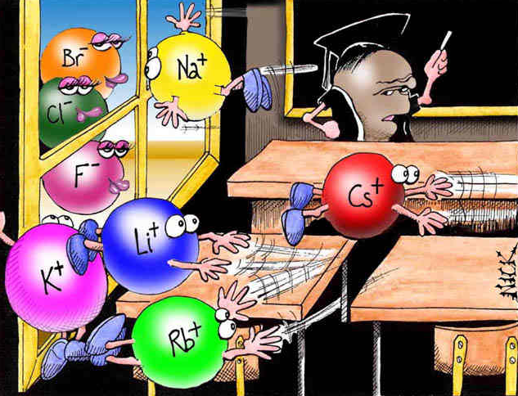
“Perhaps one of you gentlemen would mind telling me just
what is outside the window that you find so attractive..?”
Image courtesy NearingZero.net

Slide 10
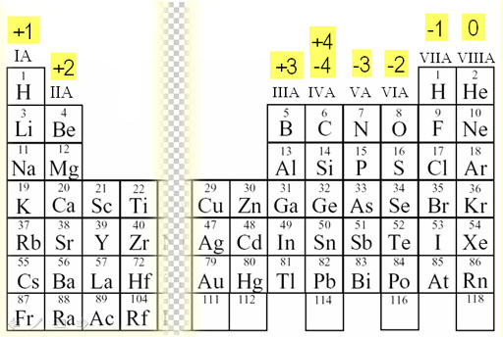
To make formula from the name
Use the crisscross rule!

Slide 11
Example: Aluminum Chloride
Criss-Cross Rule
Step 1:
write out name with space
Al Cl
3+
1-
Step 2:
write symbols & charge of elements
Al Cl
Step 3:
1
3
criss-cross charges as subsrcipts
Step 4: AlCl
3
combine as formula unit
(“1” is never shown)
Notes:
http://upload.wikimedia.org/wikipedia/commons/4/42/Aluminium-trichloride-3D-structures.png

Slide 12
Example: Magnesium Oxide
Criss-Cross Rule with Reduction
Step 1: Magnesium Oxide
Step 2: Mg²⁺ O²⁻
Step 3: Mg O
2
2
Step 4: Mg₂O₂
Step 5: MgO

Slide 13
Criss-Cross Rule
criss-cross rule:
charge on cation / anion
“becomes” subscript of anion / cation
** Warning: Reduce to lowest terms.
Al³⁺ and O^{2–}
Ba²⁺ and S^{2–}
In³⁺ and Br^{1–}
Al₂ O₃
Ba₂ S₂
In₁ Br₃
Al₂O₃
BaS
InBr₃
aluminum oxide
barium sulfide
indium bromide

Slide 14
Writing Formulas of Ionic Compounds
chemical formula:
has neutral charge;
shows types of atoms and how many of each
To write an ionic compound’s formula, we need:
1. the two types of ions
2. the charge on each ion
Na¹⁺ and F^{1–}
Ba²⁺ and O^{2–}
Na¹⁺ and O^{2–}
Ba²⁺ and F^{1–}
NaF
sodium fluoride
BaO
barium oxide
Na₂O
sodium oxide
BaF₂
barium fluoride

Slide 15
Naming Binary Compounds
Formula Name
barium oxide
BaO ____________________
________________ sodium bromide
MgI₂ ____________________
KCl ____________________
________________ strontium fluoride
________________ cesium fluoride
NaBr
magnesium iodide
potassium chloride
SrF₂
CsF

Slide 16
Type Two Binary Compounds Containing a Polyvalent Metal
To name these compounds, give the name of the metal (Type II
cations) followed by Roman numerals in parentheses to indicate
the oxidation number of the metal, followed by the name of the
nonmetal, with its ending replaced by the suffix –ide.
Examples Stock System
Traditional (OLD) System
(II)
FeCl₂
Iron chloride
Ferrous chloride
FeCl₃
Iron chloride
(III)
Ferric chloride
(II)
SnO Tin oxide
SnO₂ Tin oxide
Stannous oxide
(IV)
Stannic oxide
(“ic” ending = higher oxidation state;
“ous” is lower oxidation state)

Slide 17
Type three Polyvalent Metals with Elemental Anions
Pb²⁺/Pb⁴⁺,
Sn²⁺/Sn⁴⁺,
transition elements
(not Ag or Zn)
A. To name, given the formula:
1. Figure out charge on cation.
2. Write name of cation.
Stock System
of nomenclature
3. Write Roman numerals in ( )
to show cation’s charge.
4. Write name of anion.
FeO
Fe₂O₃
CuBr
CuBr₂
Fe O^{2–}
iron (II) oxide
?
²⁺
2 Fe 3 O^{2–}
iron (III) oxide
³⁺
?
Cu Br^{1–}
copper (I) bromide
?
¹⁺
Cu 2 Br^{1–}
copper (II) bromide
²⁺
?

Slide 18
Periodic Table with charges
Single-charge cations
1+
Multiple-charge cations
H
1
He
2
H
1
Elemental anions
1
2+
3+
3-
2-
1-
2
Li
3
Be
4
B
5
C
6
N
7
O
8
F
9
Ne
10
3
Na
11
Mg
12
Al
13
Si
14
P
15
S
16
Cl
17
Ar
18
1+
2+
4
K
19
Ca
20
Sc
21
Ti
22
V
23
Cr
24
Mn
25
Fe
26
Co
27
Ni
28
Cu
29
Zn
30
Ga
31
Ge
32
As
33
Se
34
Br
35
Kr
36
5
Rb
37
Sr
38
Y
39
Zr
40
Nb
41
Mo
42
Tc
43
Ru
44
Rh
45
Pd
46
Ag
47
Cd
48
In
49
Sn
50
Sb
51
Te
52
I
53
Xe
54
6
Cs
55
Ba
56
∗
Hf
72
Ta
73
W
74
Re
75
Os
76
Ir
77
Pt
78
Au
79
Hg
80
Tl
81
Pb
82
Bi
83
Po
84
At
85
Rn
86
7
Fr
87
Ra
88
Ω
Rf
104
Db
105
Sg
106
Bh
107
Hs
108
Mt
109
La
57
Ce
58
Pr
59
Nd
60
Pm
61
Sm
62
Eu
63
Gd
64
Tb
65
Dy
66
Ho
67
Er
68
Tm
69
Yb
70
Lu
71
Ac
89
Th
90
Pa
91
U
92
Np
93
Pu
94
Am
95
Cm
96
Bk
97
Cf
98
Es
99
Fm
100
Md
101
No
102
Lr
103

Slide 19
Polyvalent Metal Cations
Common Type II Cations
Ion Stock System Traditional System
Fe ³⁺ iron (III) ferric
Fe ²⁺ iron (II) ferrous
Cu ²⁺ copper (II) cupric
Cu ¹⁺ copper (I) cuprous
Co ³⁺ cobalt (III) cobaltic
Co ²⁺ cobalt (II) cobaltous
Sn ⁴⁺ tin (IV) stannic
Sn ²⁺ tin (II) stannous
Pb ⁴⁺ lead (IV) plumbic
Pb ²⁺ lead (II) plumbous
Hg ²⁺ mercury (II) mercuric
Hg₂ ²⁺ mercury (I) mercurous
*Mercury (I) ions are always bound together in pairs to form Hg₂ ²⁺
Zumdahl, Zumdahl, DeCoste, World of Chemistry 2002, page 90

Slide 20
Traditional (OLD) System of Nomenclature
…used historically (and still some today) to name
compounds ^{w}/multiple-charge cations
To use:
1. Use Latin root of cation.
2. Use -ic ending for higher charge
“ -ous “ “ lower “
3. Then say name of anion, as usual.
; (“icky” food is good for you!)
; (“delicious” food is not good for you!)
Element Latin root -ic -ous
gold, Au aur- Au³⁺ Au¹⁺
lead, Pb plumb- Pb⁴⁺ Pb²⁺
tin, Sn stann- Sn⁴⁺ Sn²⁺
copper, Cu cupr- Cu²⁺ Cu¹⁺
iron, Fe ferr- Fe³⁺ Fe²⁺

Slide 21
Find the oxidation State of the polyvalent metal Subscript Metal (X) + Subscript Nonmetal ( Ox #) = 0 State metal, use Roman Numeral for oxidation state, state nonmetal and change ending to ide.

Slide 22
Name this compound! Cu₃P₂
Find oxidation number of the metal :
(3) (x) + 2 (-3) = 0
X = +2
2. state the metal
state the value of the Roman Numeral
state non-metal change ending to ide
Copper II Phosphide

Slide 23
Multiple Oxidation States
“tin fluoride”
Tin is either 2+ or 4+ oxidation state.
tin (II) fluoride
tin (IV) fluoride
Sn²⁺
F¹⁻
Sn⁴⁺
F¹⁻
SnF₂
SnF₄
tin (II) sulfide
tin (II) sulfate
tin (II) sulfite
tin (IV) sulfate
Sn²⁺
S²⁻
Sn²⁺
SO₄²⁻
Sn²⁺
SO₃²⁻
Sn⁴⁺
SO₄²⁻
Sn₂S₂
SnSO₄
SnSO₃
Sn₂(SO₄)₄
SnS
Sn(SO₄)₂

Slide 24
Chromium II Chloride
RECALL: Chromium has multiple oxidation states.
Name with STOCK system.
Assume Chromiun (II).
Step 1: Chromium (II) Chloride
Step 2: Cr²⁺ Cl¹⁻
Step 3: Cr Cl
1
2
Step 4: Cr₁Cl₂
Step 5: CrCl₂
Return to Centrum Bottle

Slide 25
Tin IV Chloride Stannic Chloride
RECALL: “ic” higher oxidation & “ous” lower oxidation
Sn⁴⁺ (higher) Sn²⁺ (lower)
Step 1: Stannic (tin) Chloride
Step 2: Sn⁴⁺ Cl¹⁻
Step 3: Sn Cl
1
4
Step 4: SnCl₄
Return to Centrum Bottle

Slide 26
Chromium (III) Chloride
RECALL: Chromium forms oxides in which metal exhibits oxidation
states of +3 and +2. STOCK system indicates oxidation
state of compound. Assume Cr³⁺ (chromium (III) chloride).
Step 1: Chromium (III) Chloride
Step 2: Cr³⁺ Cl¹⁻
Step 3: Cr Cl
1
3
Step 4: CrCl₃
Return to Centrum Bottle

Slide 27
Write formulas:
Write names:
copper I sulfide
Pb₃P₄
3 Pb? 4 P^{3–}
Cu¹⁺
S^{2–}
Cu₂S
plumbic phosphide
lead (IV) phosphide
auric nitride
Pb₃P₂
3 Pb? 2 P^{3–}
Au³⁺
N^{3–}
AuN
plumbous phosphide
gold (III) nitride
lead (II) phosphide
ferrous fluoride
SnCl₄
Sn? 4 Cl^{1–}
F^{1–}
FeF₂
stannic chloride
Fe²⁺
iron (II) fluoride
tin (IV) chloride

Slide 28
Naming Binary Compounds
Formula Name
mercury (I) oxide
Hg₂O ____________________
HgO ____________________
________________ copper (II) fluoride
________________ copper (I) sulfide
Cr₂O₃ ____________________
________________ lead (IV) oxide
mercury (II) oxide
CuF₂
Cu₂S
chromium (III) oxide
PbO₂

Slide 29
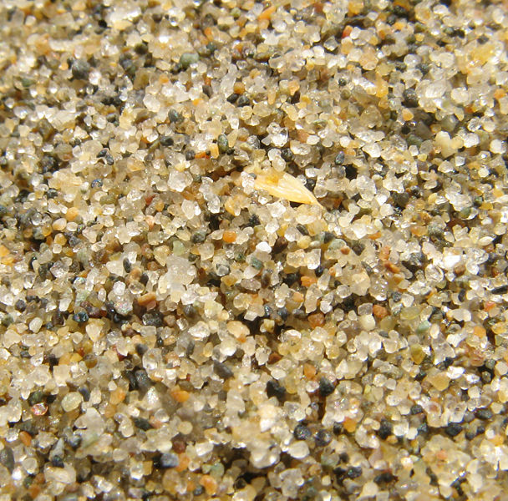
Molecular Compound
A compound containing atoms of two or more elements that are bonded together by sharing electrons.
Silicon dioxide, SiO₂, is a molecular compound. It is also a mineral called quartz (left).
Quartz is found in nearly every type of rock. Most sand grains (center) are bits of quartz.
Glass is made from sand.
Notes:
Quartz (silicon dioxide) is the most common mineral species in the earth's crust.
http://www.minvision.com/mvpics/0275331001148477692730993.jpg
http://ftp.gnome.org/pub/GNOME/teams/art.gnome.org/backgrounds/NATURE-QuartzSand_1024x768.jpg
http://en.wikipedia.org/wiki/Image:Third_beach_sand.jpg

Slide 30
Type Five Writing Formulas of Covalent Molecules
Covalent Molecules
contain two types of nonmetals
Key: FORGET CHARGES
What to do:
Use Greek prefixes to indicate how many atoms
of each element, but don’t use “mono” on first element.
1 – mono 6 – hexa
2 – di 7 – hepta
3 – tri 8 – octa
4 – tetra 9 – nona
5 – penta 10 – deca

Slide 31
Prefixes – Binary Molecular Compounds
Greek Prefixes for Two Nonmetals
Number Indicated Prefixes
1 mono-
2 di-
3 tri-
4 tetra-
5 penta-
6 hexa-
7 hepta-
8 octa-
9 nona-
10 deca-

Slide 32
Writing Formulas of Covalent Molecules
EXAMPLES:
carbon dioxide
CO
dinitrogen trioxide
N₂O₅
carbon tetrachloride
NI₃
CO₂
carbon monoxide
N₂O₃
dinitrogen pentoxide
CCl₄
nitrogen triiodide

Slide 33
Binary Compounds Containing Two Nonmetals
To name these compounds, give the name of the less electronegative
element first with the Greek prefix indicating the number of atoms of that
element present, followed by the name of the more electronegative non-
metal with the Greek prefix indicating the number of atoms of that element
present and with its ending replaced by the suffix –ide.
Prefixes you should know:
Mono Di Tri Tetra Penta Hexa Hepta Octa Nona Deca
1 2 3 4 5 6 7 8 9 10

Slide 34
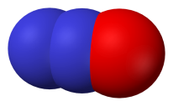
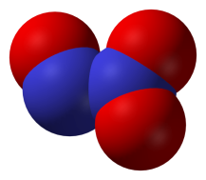
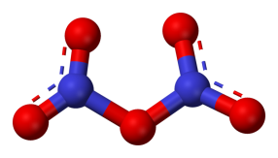
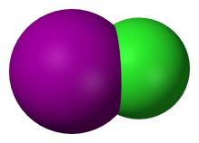
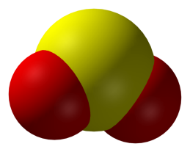
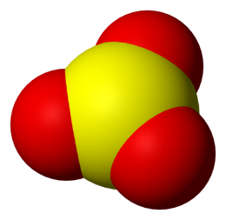
Binary Molecular Compounds
N₂O dinitrogen monoxide
N₂O₃ dinitrogen trioxide
N₂O₅ dinitrogen pentoxide
ICl iodine monochloride
ICl₃ iodine trichloride
SO₂ sulfur dioxide
SO₃ sulfur trioxide
Notes:
http://en.wikipedia.org/wiki/Image:Sulfur-dioxide-3D-vdW.png
http://en.wikipedia.org/wiki/Image:Sulfur-trioxide-3D-vdW.png
http://en.wikipedia.org/wiki/Image:Iodine-monochloride-3D-vdW.png
http://en.wikipedia.org/wiki/Image:Nitrous-oxide-3D-vdW.png
http://en.wikipedia.org/wiki/Image:Dinitrogen-trioxide-3D-vdW.png
http://en.wikipedia.org/wiki/Image:Dinitrogen-pentoxide-3D-balls.png
Technical Note: Iodine trichloride is actually a dimer with the formula I₂Cl₆

Slide 35
Binary Compounds Containing Two Nonmetals
As₂S₃
________________ diarsenic trisulfide
________________ sulfur dioxide
P₂O₅ ____________________
________________ carbon dioxide
N₂O₅ ____________________
H₂O ____________________
SO₂
diphosphorus pentoxide
CO₂
dinitrogen pentoxide
dihydrogen monoxide

Slide 36
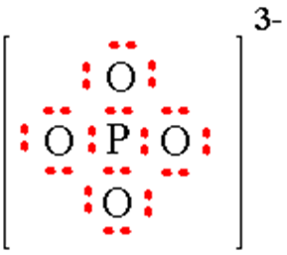
Polyatomic Ions Group of atoms that are covalently bonded that carry a charge

Slide 37
Polyatomic Ions - Memorize
Eight “-ATE’s”
PO₄^{3- ……………}
SO₄^{2- ……………}
CO₃^{2- …………..}
ClO₃^{1- …………..}
NO₃^{1- ………..….}
phosphate
sulfate
carbonate
chlorate
nitrate
phosphATE
sulfATE
carbonATE
chlorATE
nitrATE
Exceptions:
NH₄^{1+ ……………}
OH^{1- ……………}
CN^{1- …………..}
ammonium
hydroxide
cyanide

Slide 38
Polyatomic Ion:
a group of atoms that stay together and have a single, overall charge.
BrO₄¹⁻ Perbromate ion | BrO₃¹⁻ Bromate ion | BrO₂¹⁻ Bromite ion | BrO¹⁻ Hypobromite ion
CO₄²⁻ | CO₃²⁻ Carbonate ion | CO₂²⁻ | CO²⁻
ClO₄¹⁻ | ClO₃¹⁻ Chlorate ion | ClO₂¹⁻ | ClO¹⁻
IO₄¹⁻ | IO₃¹⁻ Iodate ion | IO₂¹⁻ | IO¹⁻
NO₄¹⁻ | NO₃¹⁻ Nitrate ion | NO₂¹⁻ | NO¹⁻
PO₅³⁻ | PO₄³⁻ Phosphate ion | PO₃³⁻ | PO₂³⁻
SO₅²⁻ | SO₄²⁻ Sulfate ion | SO₃²⁻ | SO₂²⁻
1 more oxygen | “normal” | 1 less oxygen | 2 less oxygen

Slide 39
Rules for Parentheses
Parentheses are used only when the following
two condition are met:
There is a radical (polyatomic ion) present and…
There are two or more of that radical in the formula.
Examples:
NaNO₃ NO₃¹⁻ is a radical, but there is only one of it.
Co(NO₃)₂ NO₃¹⁻ is a radical and there are two of them
(NH₄)₂SO₄ NH₄¹⁺ is a radical and there are two of them;
SO₄²⁻ is a radical but there is only one of it.
Co(OH)₂ OH¹⁻ is a radical and there are two of it.
Al₂(CO₃)₃ CO₃²⁻ is a radical and there are three of them.
NaOH OH¹⁻ is a radical but there is only one of it.

Slide 40
Calcium Phosphate Cross and Drop! Reduce if You Can
Step 1: Calcium Phosphate
Step 2: Ca²⁺ PO₄³⁻
Step 3: Ca (PO₄)
3
2
Step 4: Ca₃(PO₄)₂
Return to Centrum Bottle

Slide 41
Given the formula state the name of the metal and the name of the polyatomic ion
LiNO₃
Lithium Nitrate
Sr₃(PO₄)₂
Strontium Phosphate
Al(OH)₃
Aluminum Hydroxide

Slide 42
Type Two Cont Monovalent metals ^{w}/Polyatomic Ions
Parentheses are required only when you need more
than one “bunch” of a particular polyatomic ion.
Ba²⁺ and SO₄^{2–}
BaSO₄
barium sulfate
Mg²⁺ and NO₃^{1–}
Mg(NO₃)₂
magnesium nitrate
NH₄¹⁺ and ClO₃^{1–}
NH₄ClO₃
ammonium chlorate

Slide 43
Find the oxidation State of the polyvalent metal with a polyatomic ion Subscript Metal (X) + Subscript polyatomic ion( Ox #) = 0 State metal, use Roman Numeral for oxidation state, state polyatomic name
Type Four: Polyvalent metal and a Polyatomic Ion

Slide 44
Name This Compound! Cu₃(PO₄)₂
Find Oxidation state of metal
3(x) + 2(-3) = 0
X= +2 Value II
2. State metal
State value of R.N.
4. Name the polyatomic ion
Copper II Phosphate

Slide 45
Name That Compound!
Compound Ox # of Metal state metal R.N. Polyatomic
1. Pb(SO₄)₂
1(?) + 2(-2) = 0
Lead IV Sulfate
? = +4
2. Co₂(SO₄)₃
2(?) + 3(-2) = 0
Cobalt III Sulfate
? = + 3

Slide 46
Type Four Making the compounds polyvalent metals ^{w}/Polyatomic Ions Cross and Drop Reduce if Possible
Parentheses are required only when you need more than one “bunch” of a particular polyatomic ion.
tin (IV) sulfate
Sn⁴⁺ and SO₄^{2–}
Sn(SO₄)₂
iron (III) dichromate
Fe³⁺ and Cr₂O₇^{2–}
Fe₂(Cr₂O₇)₃

Slide 47
B. To find the formula, given the name:
Cross the value of the roman numeral and the oxidation of the non-metal
1. Write symbols for the two types of ions.
2. Cross and Drop Reduce if Possible!
cobalt (III) chlorate Co³⁺ ClO₃^{1–} Co(ClO₃)₃
tin (IV) sulfate Sn⁴⁺ SO₄^{2–} Sn(SO₄)₂
tin (II) Carboante Sn²⁺ CO₃^{2–} SnCO₃

Slide 48
Copper II Sulfate
RECALL: “ic” higher oxidation & “ous” lower oxidation
Cu²⁺ (higher) Cu¹⁺ (lower)
Step 1: Cupric Sulfate
Step 2: Cu²⁺ SO₄²⁻
Step 3: Cu (SO₄)
2
2
Step 4: Cu₂(SO₄)₂
Step 5: CuSO₄
Return to Centrum Bottle

Slide 49
Compounds Containing Polyatomic Ions
Insert name of ion where it should go in the compound’s name.
Cross and Drop Reduce if you can!
Write formulas:
iron (III) nitrate
Copper I phosphate
Silver chlorate
Nickel II phosphate
lead (II) permanganate
Fe³⁺
3
NO₃^{1–}
Fe(NO₃)₃
3
Cu¹⁺
PO₄3–
Cu₃PO₄
Ag¹⁺
ClO₃^{1–}
AgClO₃
3
Ni²⁺
2
PO₄^{3–}
Ni₃(PO₄)₂
Pb²⁺
2
MnO₄^{1–}
Pb(MnO₄)₂

Slide 50
Type Six Acids Hydrogen Containing Compounds
If it is binary HX use the prefix hydro state nonmetal change ending to ic acid
HBr
Hydrobromic Acid
To make the formula cross and drop charges!

Slide 51
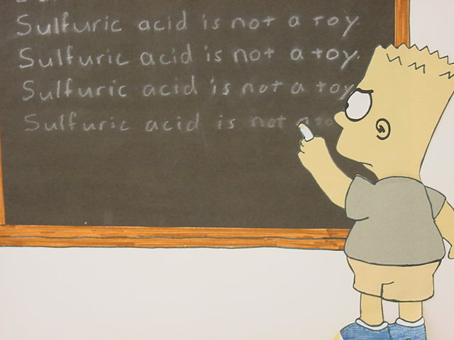
Oxy Acids: HXO_{n}

Slide 52
2. Oxy Acids
Hydrogen ______Oxygen H___O_{x}
Prefix and ending indicate number of oxygens present
+ 2 oxygens Hyper ___ic acid HClO₅ Hyperchloric Acid
+1 oxygen per____ic acid HClO₄ PerChloric Acid
Normal Poly # (ate ending) ____ic acid HClO₃ Chloric Acid
-1 oxygen ____ous acid HClO₂ Chlorous Acid
-2 oxygens Hypo ____ous acid HClO Hypochlorous Acid

Slide 53
Finding an Empirical Formula from Experimental Data
1. Find # of g of each element.
2. Convert each g to mol.
3. Divide each “# of mol” by the smallest “# of mol.”
4. Use whole number ratio to find formula.
A compound is 45.5% yttrium and 54.5% chlorine.
Find its empirical formula.
YCl₃

Slide 54
A ruthenium/sulfur compound is 67.7% Ru.
Find its empirical formula.
Multiply each by 2 to get to next whole number
Ru₂S₃

Slide 55
To find molecular formula…
A. Find empirical formula.
B. Find molar mass of
empirical formula.
C. Find n = mm molecular
mm empirical
D. Multiply all parts of
empirical formula by n.
(How many empiricals “fit into” the molecular?)

Slide 56
A carbon/hydrogen compound is 7.7% H and has a
molar mass of 78 g. Find its molecular formula.
emp. form. → CH
78 g
mm_{emp} =
13 g
= 6
C₆H₆
13 g

Slide 57
A compound has 26.33 g nitrogen, 60.20 g oxygen,
and molar mass 92 g. Find molecular formula.
NO₂
92 g
mm_{emp} =
46 g
= 2
N₂O₄
46 g

