Slide 1
MHS Chem I Topics

Slide 2
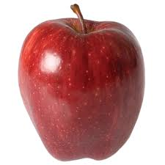
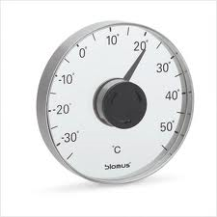
Observations
Qualitative: descriptive observation that is not numerical.
  Example: This apple is red.
Quantitative: Numerical observation.
  Example: The temperature of this room
  is 23°C.

Slide 3
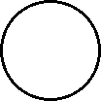


States of Matter
Difference between solids, liquids, & gases are the attractive forces amongst the particles and their energy.
Energy increases
Force of attraction increase

Slide 4
Properties of Solids, Liquids, & Gases
State | Shape | Volume | Compressibility | Microscopic Properties
Solid | Definite | Definite | Negligible | Particles touching & tightly packed in rigid arrays.
Liquid | Indefinite | Definite | Very Little | Particles touching but mobile.
Gas | Indefinite | Indefinite | High | Particles far apart and independent of one another.

Slide 5
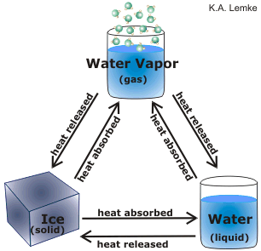
Energy and Phase Changes
Endothermic : energy/heat is absorbed
Exothermic : energy/heat is released

Slide 6
Pure Substances
Elements and compounds are pure substances.
Pure substances have a uniform and defined composition.
  Atoms of Helium always have 2 protons, 2 neutrons and 2 electrons.
  Sugar, glucose, always has 6 carbon atoms, 12 hydrogen atoms, and 6 oxygen atoms.
Pure Substances also have distinct properties.

Slide 7
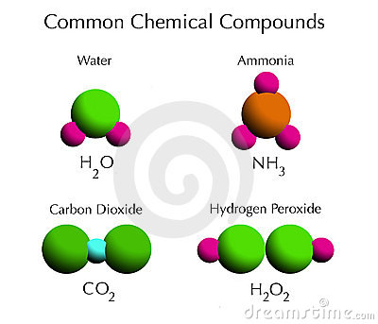
Compounds are made up of two or more different kinds of elements that are linked together via chemical bonds.

Slide 8
Mixtures
Two or more substances that are physically combined together.
Two types of mixtures
  Homogeneous mixtures have a uniform composition throughout and have the same properties throughout.
  Heterogeneous mixtures do not have a uniform composition throughout and the properties are not the same throughout.

Slide 9

Adding Liquids Together
Miscible- will mix- water and alcohol
Immiscible- wont mix
water and oil

Slide 10

Increase solubility of a gas in a liquid
Henrys Law- solubility of the gas is directly proportional to the pressure above the liquid-
Effervescence- rapid escape of gas from liquid
Decrease temperature- slows down diffusion

Slide 11
Physical & Chemical Changes
Physical changes do not change to the composition of the substance.
  Typically involve phase changes.
In any chemical change, one or more substances are used up while one or more new substances are formed. This means that the composition of the original substance has changed.
  Chemical reactions are chemical changes.

Slide 12
Indications of A Chemical Reaction
Bubbles- gas given off
Change in energy-
  Becomes warm- exothermic
  Becomes cool- endothermic
  Light is given off
A precipitate (solid) forms
A change in color

Slide 13
More on Properties
Intensive Properties are not dependent on the amount of matter present.
Depend on what is Inside
  Density, boiling point, color
Extensive Properties are dependent on the amount of matter present.
Depend on how far they EXtend
  Mass, volume, length

Slide 14
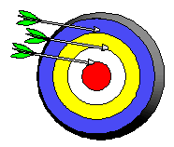
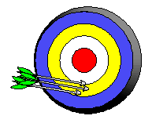
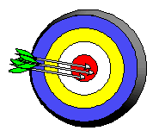
Precision and Accuracy
Accuracy refers to the agreement of a particular value with the true value.
Precision refers to the degree of agreement among several measurements made in the same manner.
Neither accurate nor precise
Precise but not accurate
Precise AND accurate

Slide 15
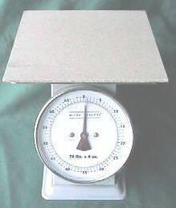
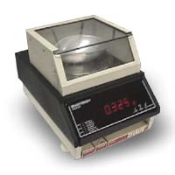
Why Is there Uncertainty?
Measurements are performed with instruments
No instrument can read to an infinite number of decimal places
Which of these balances has the greatest uncertainty in measurement?

Slide 16
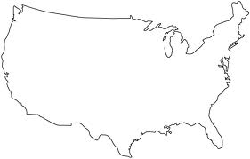
Identifying & Counting Significant Figures:
Use the Atlantic-Pacific Rule! If the decimal point is absent approach the number from the Atlantic side, go to your first non-zero number, and count all the way through. If the decimal point is present approach the number from the Pacific side go to your first non-zero number, and count all the way through.
Pacific Ocean
Atlantic Ocean

Slide 17
Sig Fig Practice #1
How many significant figures in each of the following?
1.0070 m →
5 sig figs
17.10 kg →
4 sig figs
100,890 L →
5 sig figs
3.29 x 10³ s →
3 sig figs
0.0054 cm →
2 sig figs
3,200,000 →
2 sig figs

Slide 18
Rules for Significant Figures in Mathematical Operations
Multiplication and Division: # sig figs in the result equals the number in the least precise measurement used in the calculation.
6.38 x 2.0 =
12.76 → 13 (2 sig figs)
Addition and Subtraction: The number of decimal places in the result equals the number of decimal places in the least precise measurement.
6.8 + 11.934 =
18.734 → 18.7 (3 sig figs)

Slide 19
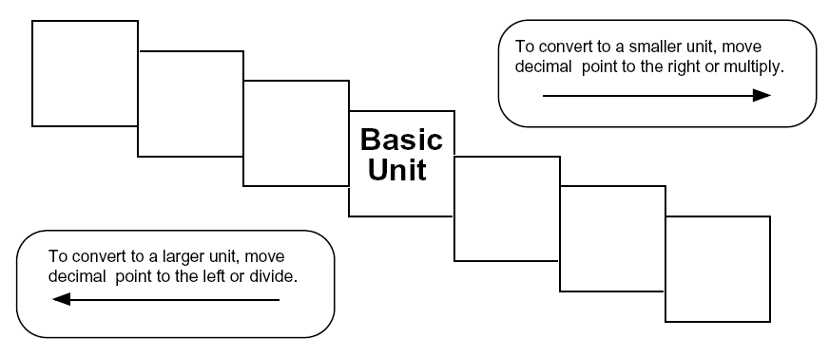
Ladder Method
1
2
KILO
1000
Units
3
HECTO
100
Units
DEKA
10
Units
DECI
0.1
Unit
CENTI
0.01
Unit
MILLI
0.001
Unit
Meters
Liters
Grams
How do you use the “ladder” method?
4 km = _________ m
1st – Determine your starting point.
2nd – Count the “jumps” to your ending point.
3rd – Move the decimal the same number of jumps in the same direction.
Starting Point
Ending Point
How many jumps does it take?
4.
__.
__.
__.
= 4000 m
1
2
3

Slide 20
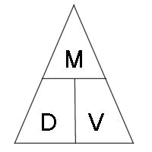
Density- the amount of matter in a unit of volume- can be used for identification purposes!
Using the density triangle – any variable equation can be found by covering the unknown-

Slide 21
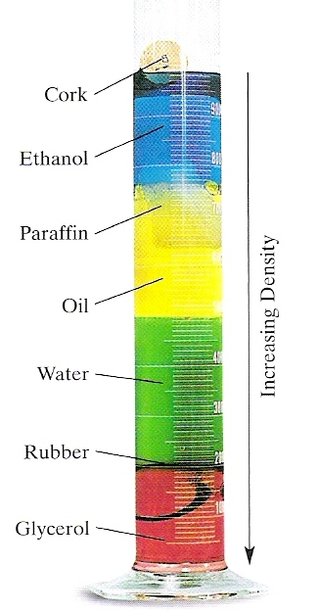
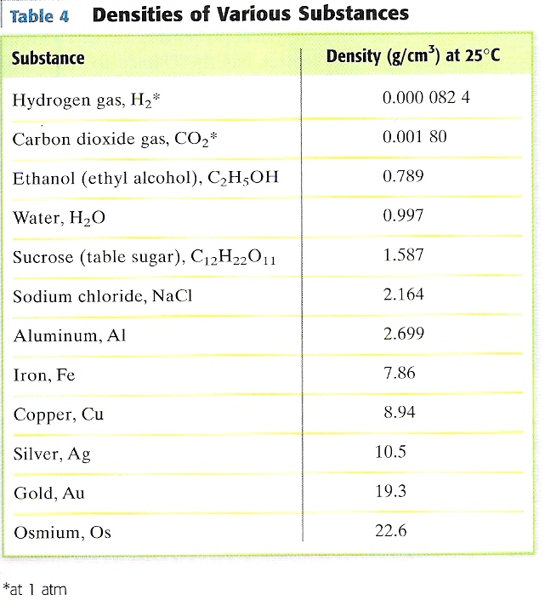
What can you conclude about the density of rubber, glycerol, oil, paraffin and cork?

Slide 22
Heat Capacity
Amount of energy required to change a given sample by a given amount
Q = m C Δ T
Q= Heat= Joules
C= specific heat (table value) J/g⁰c
(unique to material)
Δ T = T_{Final} – T_{Initial}

Slide 23
Problems
1. a. How much energy is required to warm 5.00 grams of copper from 22.00c to 40.00c?
b. How much energy is lost when 2.00 grams of lead is cooled from 25.00c to 15.00c?
Find Mass
2. a. How many grams of water are in a sample if it required 166 joules of energy to be warmed from 20.00c to 40.00c?

Slide 24
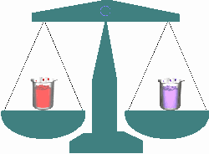
Law of Conservation of Matter
Mass is not created (gained) nor destroyed (lost) during ordinary physical and chemical reactions.
Proven by Antoine Lavoisier 200 years ago

Slide 25
Law of Definite Proportions
Chemical compound contains the same elements in exactly the same proportions by mass regardless of sample size or source of substance
1700’s Joseph Proust
We all know the chemical formula for water is H₂O . It is essential for the body. The water from a Poland Spring bottle and from a your tap at home is always 2 hydrogen atoms to 1 oxygen atom

Slide 26
Law of Multiple Proportions
Two elements may combine in different ratios to form different compounds.
Change the ratio …Change the compound
John Dalton
Water is composed of hydrogen and oxygen in a 2 to 1 ratio needed for body
Hydrogen Peroxide is H₂O₂ in a ratio of 2 to 2. Used as an antiseptic poisonous to body

Slide 27
Dalton’s Atomic Theory (1803)
Matter is composed of extremely small particles called atoms.
Atoms are indivisible and indestructible.
Atoms of a given element are identical in size, mass, and chemical properties.
Atoms of a specific element are different from those of another element.
Atoms combine in simple whole number ratios to form compounds.
In a chemical reaction, atoms are separated, combined, or rearranged.

Slide 28
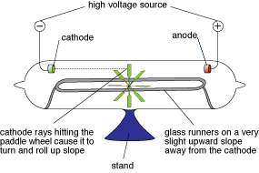
Discovery of the Electron
In 1897, J.J. Thomson used a cathode ray tube to deduce the presence of a negatively charged particle.
Cathode ray tubes pass electricity through a gas that is contained at a very low pressure.

Slide 29
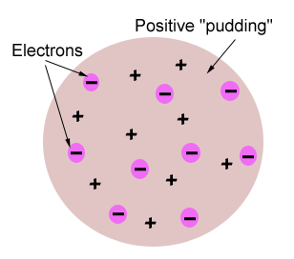
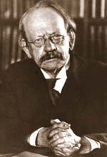
Thomson’s Atomic Model
Thomson believed that the electrons were like plums embedded in a positively charged “pudding,” thus it was called the “plum pudding” model.

Slide 30
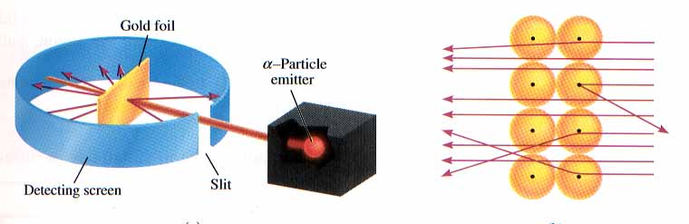
Rutherford’s Gold Foil Experiment
Alpha particles are helium nuclei which are large, positively charged particles
Particles were fired at a thin sheet of gold foil
Particle hits on the detecting screen (film) are recorded

Slide 31
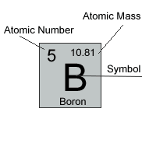
Determining Atomic Structure
Atomic Number is equal to the number of protons in the nucleus.
Abbreviated as Z
  It is like a social security number because it identifies the element.
  No two elements have the same atomic number.
Element | # of protons | Atomic # (Z)
Carbon | 6 | 6
Phosphorus | 15 | 15
Gold | 79 | 79

Slide 32
Mass Number
Mass number is the number of protons and neutrons in the nucleus of an isotope.
Mass # = p⁺ + n⁰
Nuclide | p⁺ | n⁰ | e⁻ | Mass #
Oxygen - |  | 10
- | 33 | 42
- 31 | 15
18
8
8
18
Arsenic
75
33
75
Phosphorus
16
15
31
Mass # is abbreviated as A

Slide 33
Nuclear Symbols
Mass number
(p⁺ + nº)
Element symbol
Atomic number
(number of p⁺)

Slide 34
Valence electrons
Valence electrons: an electron that is able to be lost gained or shared during bonding, due to it’s location in the outer shell of the electron cloud.
Number of Valence electrons = group number

Slide 35
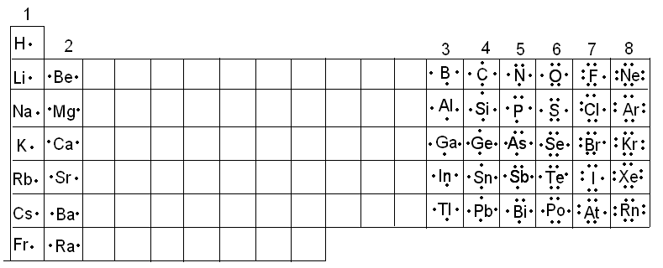
Lewis Dot Diagrams
Shows the kernel of the atom ( all inner shells and nucleus) as the symbol and dots represent the outer electrons- Valence Electrons

Slide 36
Types of Radioactive Decay
4
2+
alpha production (α): helium nucleus
beta production (β):
He
2
0
e
−
1

Slide 37
Nuclear Fission and Fusion
Fusion: Combining two light nuclei to form a heavier, more stable nucleus.
Fission: Splitting a heavy nucleus into two nuclei with smaller mass numbers.

Slide 38
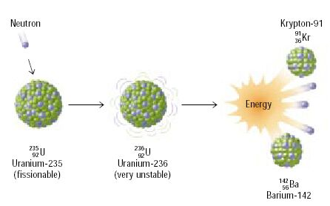
Fission

Slide 39
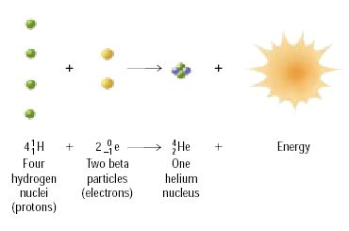
Fusion

Slide 40
Half-Life
Amount of time it takes for one half of a sample of radioactive atoms to decay

Slide 41
Half-Life Calculation #1
You have 400 mg of a radioisotope with a half-life of 5 minutes. How much will be left after 30 minutes?

Slide 42
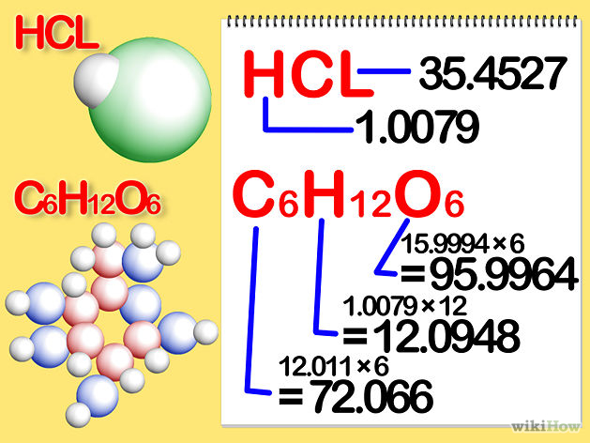
Find the molar mass of each element in the compound. Multiply the element's atomic mass by the molar mass constant by the number of atoms of that element in the compound. Here's how you do it:
For hydrogen chloride, HCl, the molar mass of each element is 1.007 grams per mole for hydrogen and 35.453 grams per mole for chlorine.
For glucose, C₆H₁₂O₆, the molar mass of each element is 12.0107 times 6, or 72.0642 grams per mole for carbon; 1.007 times 12, or 12.084 grams per mole for hydrogen; and 15.9994 times 6, or 95.9964 grams per mole for oxygen.

Slide 43
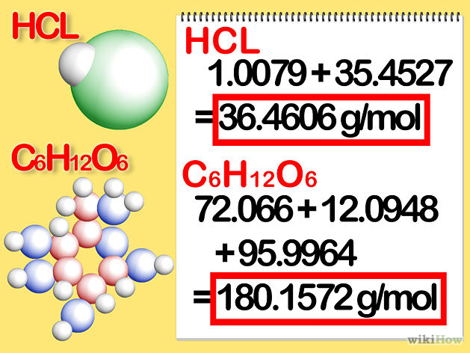
Molar Mass
Add the molar masses of each element in the compound. This determines the molar mass for the compound. Here's how you do it:
For hydrogen chloride, the molar mass is 1.007 + 35.453, or 36.460 grams per mole.
For glucose, the molar mass is 72.0642 + 12.084 + 95.9964, or 180.1446 grams per mole.

Slide 44
Calculating Percent by Mass
What is the percent by mass of metal in the compound copper II phosphate? ( Cu₃(PO₄)₂ )
Find total mass
Find mass due to the part
Divide mass of part by total
Multiply by 100
( Cu₃(PO₄)₂ )
subscript from P.T.
Cu 3 x 63.55 +
P 2 X 30.97 +
O 8 x 16.00 =
Total mass= 380.59 amu
Mass of metal = 190.7 amu
190.7 x 100 = 50.1%
380.59

Slide 45
What are moles??
Chemistry counting unit
Used to count atoms or particles
One mole of any substances contains 6.022x10²³ atoms or particles
  Particles is somewhat of a generic term that represents a minute piece of matter; like an atom, ion or molecule.
6.022 x10²³
6.022 x10²³

Slide 46
Examples
How many atoms of Carbon are in 2.25 moles of C?
How many grams are in 3.456 moles of Calcium?
How many atoms are in 340g of Magnesium?

Slide 47
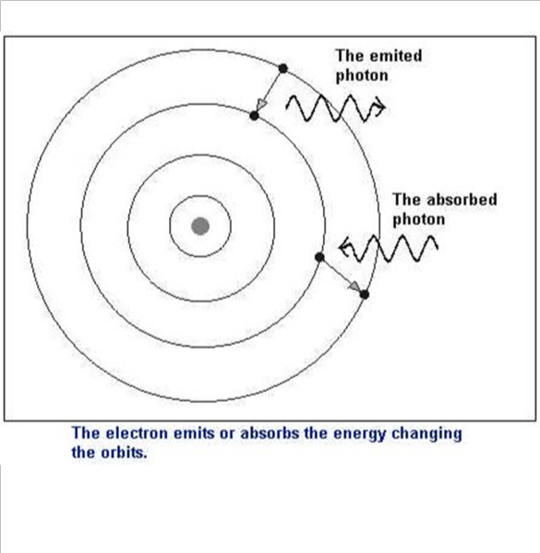
Emision Spectra

Slide 48
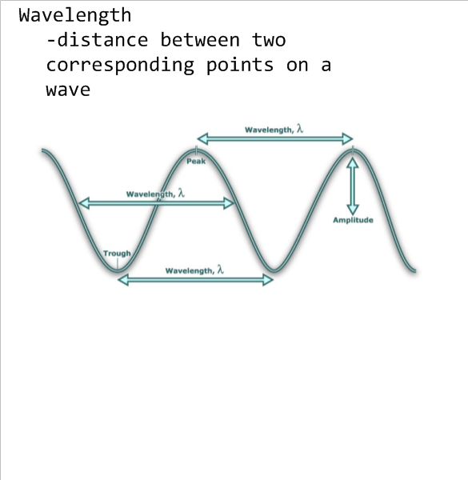

Slide 49
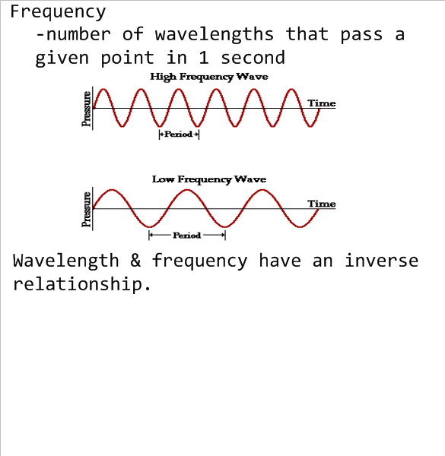

Slide 50
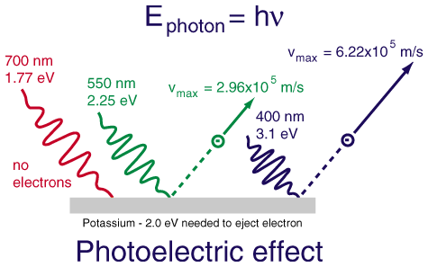
Photoelectric Effect

Slide 51
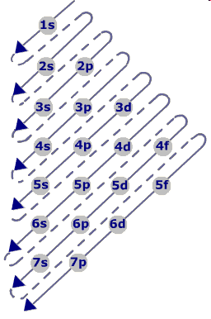
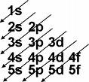
How do electrons fill in an atom?
The Diagonal Rule

Slide 52
How to fill
1 Find total # of electrons
2 Write subshells in order of diagonal rule
3. Fill in subshells till all electrons are used
4. Last subshell may be partially filled.
Sublevel # of electrons can hold
S 2
    P 6
    D 10
    F 14

Slide 53
Standard Notation of Fluorine
Number of electrons
in the sub level 2,2,5
1s² 2s² 2p⁵
Main Energy Level Numbers 1, 2, 2
Sublevels

Slide 54
Steps for Noble Gas Configuration
1 Find element on periodic table.
2 Find number of electrons
3 Find Group 8 element from period above target element
4 Write group 8 element symbol in [brackets]
5 Subtract noble gases electrons from initial elements
6 Start filling from S subshell of initial elements period # til all electrons are placed

Slide 55
Orbital Notation or Diagrams
Simply use horizontal lines and arrows instead of exponents to represent the electrons
1 arrow = 1electron Each line holds 2 electrons
# of lines for S P D F must be able to hold same number of electrons as in longhand electron configuration
S = 2e⁻ so 1 line P= 6e⁻ so 3 lines d=10e⁻ so 5 lines
f= 14e⁻ so 7 lines
___ ___ ___ ___ ___ ___ ___ ___ ___
1s 2s 2p 3s 3p

Slide 56
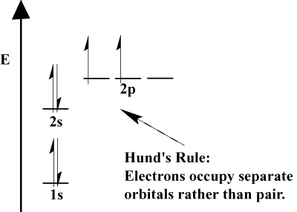
Rules for electron filling:
Aufbaus Rule- must fill the lowest energy level available first!
Hunds Rule -1 electron in each orbital of a sublevel before pairing begins
Must fill all seats on the bus before doubling up!
Pauli Exclusion Principle-2 electrons occupying the same orbital must have opposite spins- 1 up 1 down

Slide 57
Element | Configuration notation | Orbital notation | Noble gas notation
Lithium | 1s²2s¹ | ____ ____ ____ ____ ____ 1s 2s 2p | [He]2s¹
Beryllium | 1s²2s² | ____ ____ ____ ____ ____ 1s 2s 2p | [He]2s²
Boron | 1s²2s²p¹ | ____ ____ ____ ____ ____ 1s 2s 2p | [He]2s²p¹
Carbon | 1s²2s²p² | ____ ____ ____ ____ ____ 1s 2s 2p | [He]2s²p²
Nitrogen | 1s²2s²p³ | ____ ____ ____ ____ ____ 1s 2s 2p | [He]2s²p³
Oxygen | 1s²2s²p⁴ | ____ ____ ____ ____ ____ 1s 2s 2p | [He]2s²p⁴
Fluorine | 1s²2s²p⁵ | ____ ____ ____ ____ ____ 1s 2s 2p | [He]2s²p⁵
Neon | 1s²2s²p⁶ | ____ ____ ____ ____ ____ 1s 2s 2p | [He]2s²p⁶

Slide 58

Mendeleev (1869) Organized elements according to atomic weights BUT switched numerous elements around to “fit” characteristics of a different group! (Te & I) Left gaps where he hypothesized new elements would be found and Fit IN (gallium & the Nobel Gases)

Slide 59
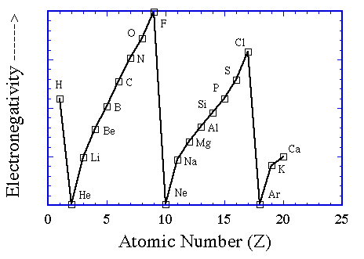

Mendeleevs Table (1871)
Periodic Law- The physical and chemical properties of the elements are periodic functions of their atomic numbers ( repeat at regular intervals)
Periodicity- Patterns evolve

Slide 60


History Continues
Strutt and Ramsey- (1894) Found Noble Gaes and add a new “group” to Periodic Table- Mendeleev hypothesized would be there
Mosely (1911) used x-rays to count protons in nucleus added Atomic Number to table Gave Experimental justifications for Mendeleevs Table (switching elements around)

Slide 61
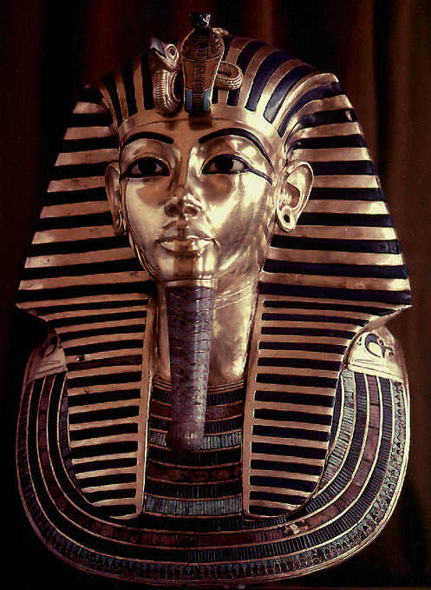
Properties of Metals
Metals are good conductors of heat and electricity
Metals are malleable (can be shaped)
Metals are ductile (can be drawn into wires)
Metals have high tensile strength
Metals have luster (shiny)

Slide 62
Properties of Nonmetals
Carbon, the graphite in “pencil lead” is a great example of a nonmetallic element.
Nonmetals are poor conductors of heat and
electricity
Nonmetals tend to be brittle
Many nonmetals are gases at room temperature

Slide 63
Coulomb Force Law, Qualitatively
F = (k·Q₁·Q₂) / r²
Double one of the charges
  force doubles
Change sign of one of the charges
  force changes direction
Change sign of both charges
  force stays the same
Double the distance between charges
  force four times weaker
Double both charges
  force four times stronger

Slide 64

Determination of Atomic Radius:
Half of the distance between nuceli in
covalently bonded diatomic molecule
"covalent atomic radii"
Periodic Trends in Atomic Radius
Across a Period Radius → decreases
Increased effective nuclear charge due
to decreased shielding (hold from nucleus on e-)
Down a Group ↓ Radius increases
Addition of principal quantum levels (shells)

Slide 65
Ionization Energy - the energy required to remove an electron from an atom
Increases for successive electrons taken from
the same atom
Tends to increase across a period
Electrons in the same quantum level do
not shield as effectively as electrons in
inner levels
Irregularities at half filled and filled
sublevels due to extra repulsion of
electrons paired in orbitals, making them
easier to remove
Tends to decrease down a group
Outer electrons are farther from the
nucleus

Slide 66
The Reason for EVERY TREND
Down a Group-
Elements are gaining shells therefore the hold on the valence electron farther from nucleus and is SHEILDED by the inner shells nuclear force (hold on electrons by nucleus) is less
Across a Period-
Elements have the same number of shells BUT number of protons is increasing in the nucleus creating a greater nuclear force pulling electrons toward the nucleus- Zeff

Slide 67
Electronegativity
A measure of the ability of an atom in a chemical bond to attract electrons toward itself
Across period → tend to increase –ZEFF more effective
(attraction nucleus has for more e-)
Down a Group ↓ decrease or remain the same
(atom becomes bigger harder to hold e in outer ring because of shielding effect from nucleus)

Slide 68
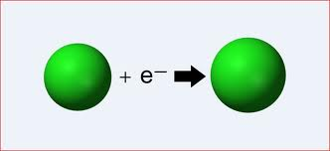
Electron Affinity
Energy change when an e- is added to a neutral atom
Metals- positive values-do not want to acquire more electrons endothermic process requiring energy to accept the e-
Non-metals- negative or zero affinity values- want to acquire more e- to achieve octet- gives off energy when acquired- exothermic-

Slide 69
For Review:
Valence electrons
Outermost electrons of the atom
Responsible for reactivity of the atom
Metals have low numbers, will tend to loose electrons to become stable with octet
Nonmetals high number of valence electrons- tend to gain more to become stable with octet

Slide 70
Creating Ions
Oxidation Numbers- number that indicates how many electrons an atom gains or looses to become stable
Draw sketch of PT with valence electrons (HOP SKOTCH)
All elements want to achieve an octet , how will each group do that two choices gain or loose / share valence electrons

Slide 71
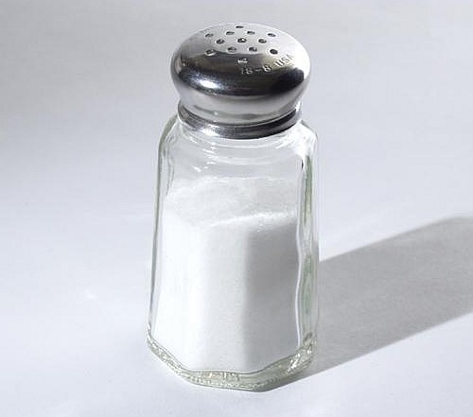
Type ONE
Simple Binary Compounds
Only Two Elements
Monovalent metal and a non-metal
State metal then non-metal change ending to ide

Slide 72
Binary Compounds
1+
1
H
1
2+
3+
He
2
2
Li
3
Be
4
B
5
C
6
N
7
O
8
F
9
Ne
10
3
Na
11
Mg
12
1+
2+
Al
13
Si
14
P
15
S
16
Cl
17
Ar
18
4
K
19
Ca
20
Sc
21
Ti
22
V
23
Cr
24
Mn
25
Fe
26
Co
27
Ni
28
Cu
29
Zn
30
Ga
31
Ge
32
As
33
Se
34
Br
35
Kr
36
Binary compounds that contain a metal of fixed oxidation number
(group 1, group 2, Al, Zn, Ag, etc.), and a non-metal.
Rb
37
Sr
38
Y
39
Zr
40
Nb
41
Mo
42
Tc
43
Ru
44
Rh
45
Pd
46
Ag
47
Cd
48
In
49
Sn
50
Sb
51
Te
52
I
53
Xe
54
5
6
Cs
55
Ba
56
∗
Hf
72
Ta
73
W
74
Re
75
Os
76
Ir
77
Pt
78
Au
79
Hg
80
Tl
81
Pb
82
Bi
83
Po
84
At
85
Rn
86
7
Fr
87
Ra
88
Ω
Rf
104
Db
105
Sg
106
Bh
107
Hs
108
Mt
109
To name these compounds, give the name of metal followed by the
name of the non-metal, with the ending replaced by the suffix –ide.
Examples:
NaCl
sodium chlor
ide
ine
(Na¹⁺ Cl¹⁻)
CaS
calcium sulf
ide
ur
(Ca²⁺ S²⁻)
AlI₃
aluminum iod
ine
ide
(Al³⁺ I¹⁻)
3

Slide 73
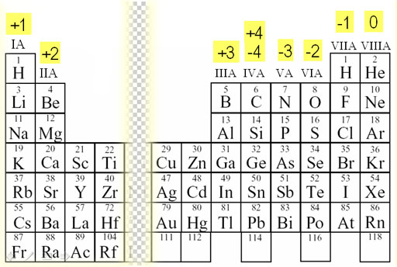
To make formula from the name
Use the crisscross rule!

Slide 74
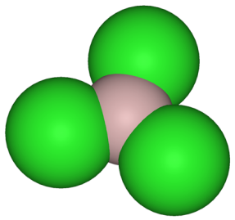
Example: Aluminum Chloride
Criss-Cross Rule
Step 1:
write out name with space
Al Cl
3+
1-
Step 2:
write symbols & charge of elements
Al Cl
Step 3:
1
3
criss-cross charges as subsrcipts
Step 4: AlCl
3
combine as formula unit
(“1” is never shown)
Notes:
http://upload.wikimedia.org/wikipedia/commons/4/42/Aluminium-trichloride-3D-structures.png

Slide 75
Example: Magnesium Oxide
Criss-Cross Rule with Reduction
Step 1: Magnesium Oxide
Step 2: Mg²⁺ O²⁻
Step 3: Mg O
2
2
Step 4: Mg₂O₂
Step 5: MgO

Slide 76

Criss-Cross Rule
criss-cross rule:
charge on cation / anion
“becomes” subscript of anion / cation
** Warning: Reduce to lowest terms.
Al³⁺ and O^{2–}
Ba²⁺ and S^{2–}
In³⁺ and Br^{1–}
Al₂ O₃
Ba₂ S₂
In₁ Br₃
Al₂O₃
BaS
InBr₃
aluminum oxide
barium sulfide
indium bromide

Slide 77
Writing Formulas of Ionic Compounds
chemical formula:
has neutral charge;
shows types of atoms and how many of each
To write an ionic compound’s formula, we need:
1. the two types of ions
2. the charge on each ion
Na¹⁺ and F^{1–}
Ba²⁺ and O^{2–}
Na¹⁺ and O^{2–}
Ba²⁺ and F^{1–}
NaF
sodium fluoride
BaO
barium oxide
Na₂O
sodium oxide
BaF₂
barium fluoride

Slide 78
Naming Binary Compounds
Formula Name
barium oxide
BaO ____________________
________________ sodium bromide
MgI₂ ____________________
KCl ____________________
________________ strontium fluoride
________________ cesium fluoride
NaBr
magnesium iodide
potassium chloride
SrF₂
CsF

Slide 79
Type Two Binary Compounds
Containing a Polyvalent Metal
To name these compounds, give the name of the metal (Type II
cations) followed by Roman numerals in parentheses to indicate
the oxidation number of the metal, followed by the name of the
nonmetal, with its ending replaced by the suffix –ide.
Examples Stock System
Traditional (OLD) System
(II)
FeCl₂
Iron chloride
Ferrous chloride
FeCl₃
Iron chloride
(III)
Ferric chloride
(II)
SnO Tin oxide
SnO₂ Tin oxide
Stannous oxide
(IV)
Stannic oxide
(“ic” ending = higher oxidation state;
“ous” is lower oxidation state)

Slide 80
Find the oxidation State of the polyvalent metal
Subscript Metal (X) + Subscript Nonmetal ( Ox #) = 0
State metal, use Roman Numeral for oxidation state, state nonmetal and change ending to ide.

Slide 81
Type three Polyvalent Metals with Elemental Anions
Pb²⁺/Pb⁴⁺,
Sn²⁺/Sn⁴⁺,
transition elements
(not Ag or Zn)
A. To name, given the formula:
1. Figure out charge on cation.
2. Write name of cation.
Stock System
of nomenclature
3. Write Roman numerals in ( )
to show cation’s charge.
4. Write name of anion.
FeO
Fe₂O₃
CuBr
CuBr₂
Fe O^{2–}
iron (II) oxide
?
²⁺
2 Fe 3 O^{2–}
iron (III) oxide
³⁺
?
Cu Br^{1–}
copper (I) bromide
?
¹⁺
Cu 2 Br^{1–}
copper (II) bromide
²⁺
?

Slide 82
Find the oxidation State of the polyvalent metal
Subscript Metal (X) + Subscript Nonmetal ( Ox #) = 0
State metal, use Roman Numeral for oxidation state, state nonmetal and change ending to ide.

Slide 83
Type Six Acids
Hydrogen Containing Compounds
If it is binary HX use the prefix hydro state nonmetal change ending to ic acid
HBr
Hydrobromic Acid
To make the formula cross and drop charges!

Slide 84
Law of Definite Proportions
Chemical compound contains the same elements in exactly the same proportions by mass regardless of sample size or source of substance
1700’s Joseph Proust
We all know the chemical formula for water is H₂O . It is essential for the body. The water from a Poland Spring bottle and from a your tap at home is always 2 hydrogen atoms to 1 oxygen atom

Slide 85
Finding an Empirical Formula from Experimental Data
1. Find # of g of each element.
2. Convert each g to mol.
3. Divide each “# of mol” by the smallest “# of mol.”
4. Use whole number ratio to find formula.
A compound is 45.5% yttrium and 54.5% chlorine.
Find its empirical formula.
YCl₃

Slide 86
A ruthenium/sulfur compound is 67.7% Ru.
Find its empirical formula.
Multiply each by 2 to get to next whole number
Ru₂S₃

Slide 87
To find molecular formula…
A. Find empirical formula.
B. Find molar mass of
empirical formula.
C. Find n = mm molecular
mm empirical
D. Multiply all parts of
empirical formula by n.
(How many empiricals “fit into” the molecular?)

Slide 88
A carbon/hydrogen compound is 7.7% H and has a
molar mass of 78 g. Find its molecular formula.
emp. form. → CH
78 g
mm_{emp} =
13 g
= 6
C₆H₆
13 g

Slide 89
A compound has 26.33 g nitrogen, 60.20 g oxygen,
and molar mass 92 g. Find molecular formula.
NO₂
92 g
mm_{emp} =
46 g
= 2
N₂O₄
46 g

Slide 90
Chemical Bonds
Forces that hold groups of atoms
together and make them function
as a unit. 3 Major Types:
Ionic bonds – transfer of electrons from metallic element to nonmetallic element
Covalent bonds – sharing of electron pair between two atoms
Metallic- de-localized electrons shared among metals

Slide 91
Ionic Bonding:
The Formation of Sodium Chloride
This transfer forms ions, each with an octet:
Cation→ Na⁺ 1s²2s²2p⁶
Anion→Cl⁻ 1s²2s²2p⁶3s²3p⁶

Slide 92
When ionic bonds occur, metals are oxidized and non-metals are reduced
Oxidation- Loss of electron(s)
(metallic element)
Na → Na⁺ + 1 e⁻
Reduction- Gain of electron(s)
(non-metallic element)
Cl + 1 e- → Cl⁻¹

Slide 93
Ionic Bonding:
The Formation of Sodium Chloride
The resulting ions come together due to electrostatic attraction (opposites attract) and are held together tightly:
Na⁺
Cl⁻
The net charge on the compound must equal zero

Slide 94
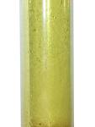
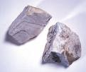
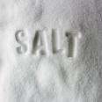
In a Direct Union (Synthesis), as in all reactions, the reactants lose their properties and a NEW substance with different properties forms!!!!
Sodium Metal + Chlorine Gas → Sodium Chloride
+
→
Silver-colored Metal
Poisonous Green Gas
White Crystal

Slide 95
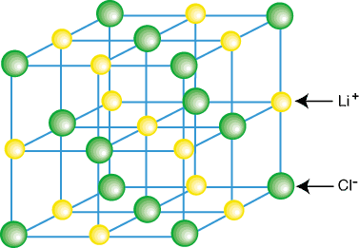
Representation of Components in an Ionic Solid
Lattice: A 3-dimensional system of points designating the centers of components (atoms, ions, or molecules) that make up the substance alternating positive and negative ions.

Slide 96
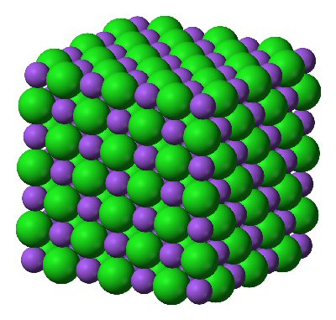
Lattice Energy
The energy given off when oppositely charged ions in the gas phase come together to form a solid.
Can judge strength of bond
Highly Negative= Strong Attraction

Slide 97
Properties of Ionic Compounds
IPF | HIGH particles are “locked” together
State | Crystalline solids
Melting point: | Generally high
Boiling Point: | Generally high
Electrical Conductivity: | Excellent conductors, molten and aqueous
Solubility in water: | Generally Quite Soluble
Volatility (ability to evaporate) | Low

Slide 98
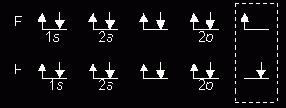
The Octet Rule – Covalent Compounds
Covalent compounds tend to form so that each atom, by sharing electrons, has an octet of electrons in its highest occupied energy level. The P orbitals overlap and electrons are shared
Diatomic Fluorine

Slide 99
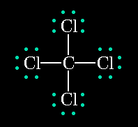
Lewis Structures
Shows how valence electrons are arranged among atoms in a molecule.
Reflects central idea that stability of a compound relates to noble gas electron configuration.

Slide 100
Completing a Lewis Structure -CH₃Cl
Make carbon the central atom
Join peripheral atoms
to the central atom
with electron pairs.
Complete octets on
atoms other than
hydrogen with remaining
electrons
Is this molecule polar?
H
..
..
H
..
C
..
..
Cl
..
..
H

Slide 101
Properties of Covalent Compounds
IMF: Phase: | Varies Solid, liquid or gaseous
Melting point: | Varies depends on IMF
Boiling Point: | Varies
Electrical Conductivity: | Will not conduct under any conditions
Solubility in water: | Some are soluble but remain as a molecule
Volatility | Ranges depends on IMF

Slide 102
In A Glance: Ionic Covalent
Phase: | Crystalline solids | Solid, Liquid, or Gas
Force of Attraction between particles | High | Ranges
Melting point: | Generally high | Lower than Ionic
Boiling Point: | Generally high | Lower than Ionic
Conductivity: | Excellent conductors, molten and aqueous | NEVER!!!
Solubility water: | Quite Soluble | Ranges- Some are others aren’t dep on IMF
Volatility | Low | Ranges

Slide 103
Ionic Bonds are NOT necessarily stronger than Covalent Bonds !!!!!
Would be comparing apples and oranges!
Could look at bond length and lattice energy BUT NOT THE SAME-
Think about melting points…
Nitrogen- Strong Covalent bond- gas
Sodium Chloride- Strong Ionic Bond- Solid

Slide 104
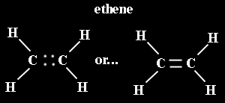
Multiple Covalent Bonds:
Double bonds
Two pairs of shared electrons

Slide 105

Multiple Covalent Bonds:
Triple bonds
Three pairs of shared electrons

Slide 106
Electronegativity difference between the atoms determine the type of bond that will form between atoms (see table on next slide)
How do we tell what type of bond will form
If the difference is greater than 1.7 the bond will be mostly ionic in character
If the difference is below 1.6 the bond will be mostly covalent in character:
Two types:
Polar Covalent unequal sharing (1.6-0.4) &
Non Polar Covalent equal sharing (0-0.3)

Slide 107
Predicting a VSEPR Structure
Draw Lewis structure.
2. Put pairs as far apart as possible
3. Determine positions of atoms from the way
electron pairs are shared.
4. Determine the name of molecular
structure from positions of the atoms.

Slide 108
VSPER MODELS TO KNOW
2 Substituents ➔ Linear (180⁰ angle)
2 Subs +1 or 2 unshared pair → Bent
3 Subs ➔ Triangular planar (120⁰ angle)
3 Subs + 1 unshared pair → Trigonal Pyramidal (<120 )
4 Substituents ➔ Tetrahedral (109.5º angle)

Slide 109
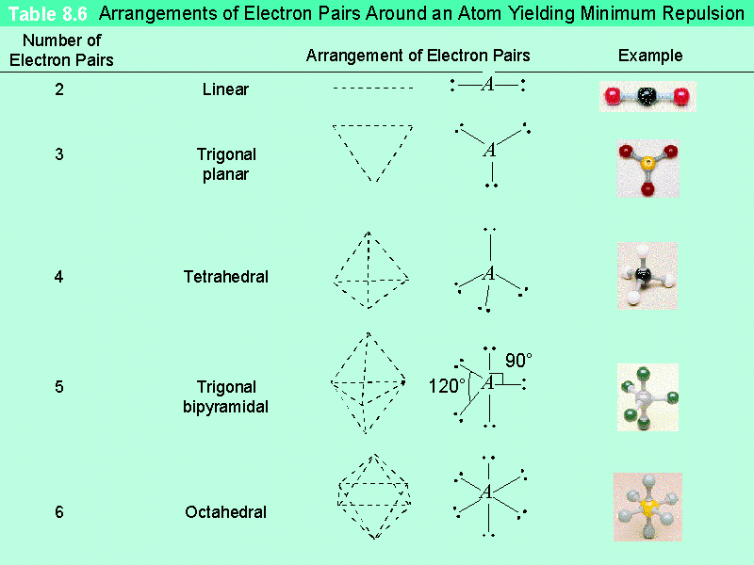

Slide 110
Parts of a chemical reaction and symbols
CH_{4 (g)} + 2O_{2(g)} → CO₂ _{(g)} + 2 H₂O _{(g)}
Reactants- starting materials yeilds/ Products- ending materials makes
Gas (s) solid (l) liquid (aq) aqueous- dissolved in water
gas product solid product (when above the arrow) heated
Anything written above the arrow is a catalyst (makes reaction go faster)
Subscripts represent # atoms in molecule and CAN NOT be changed
Coefficent- number in front of formula represents number of molecules in reaction

Slide 111
How to recognize which type
Look at the reactants
    Element(E), Compound(C)
E + E
C
E + C
C + C
Look at the Products
CO₂ + H₂O
Synthesis
Decomposition
Redox
Single replacement
Double replacement
Combustion

Slide 112
3. Decomposition Reactions
Decomposition reactions occur when a compound breaks up into the elements or in a few to simpler compounds
1 Reactant → Product + Product
In general: AB → A + B
Example: 2 H₂O → 2H₂ + O₂
Example: Mg(ClO₃)₂ → MgCl₂ + 3 O₂

Slide 113
Decomposition Exceptions
Carbonates and chlorates are special case decomposition reactions that do not go to the elements.
  Carbonates (CO₃²⁻) decompose to carbon dioxide and a metal oxide
    Example: CaCO₃ → CO₂ + CaO

Slide 114
Chlorate Decomposition
  Chlorates (ClO₃⁻) decompose to oxygen gas and a metal chloride
  Example: 2 Al(ClO₃)₃ → 2 AlCl₃ + 9 O₂

Slide 115
To Double Replace or Not to Double Replace? That is the Question?
Will only happen if one of the products
  doesn’t dissolve in water and forms an insoluble solid (s), precipitate (ppt).
  or is a gas that bubbles out.
  or water forms, H₂O (neutralization reaction).

Slide 116
Net Ionic Equations
These are the same as total ionic equations, but you should cancel out ions that appear on BOTH sides of the equation
Total Ionic Equation:
2 K⁺ + CrO₄ ⁻² + Pb⁺² + 2 NO₃⁻ →
PbCrO₄ (s) + 2 K⁺ + 2 NO₃⁻
Net Ionic Equation:
CrO₄ ⁻² + Pb⁺² → PbCrO₄ (s)
Spect Ions K⁺ , NO₃⁻¹

Slide 117
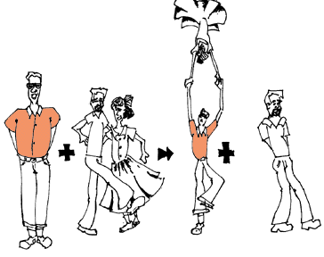
2. Single Replacement Reactions
One element replaces another in a compound.
A metal can replace a metal (+) OR
a nonmetal can replace a nonmetal (-).
element + compound→ product + product
  A + Bx → Ax + B (if A is a metal) OR
  y + Bx → By + x (if y is a nonmetal)
(remember the cation always goes first!)
When H₂O splits into ions, it splits into
H⁺ and OH⁻ (not H+ and O⁻² !!)

Slide 119
Metal Replacing a Metal
The elemental metal must be higher in the activity series in order to replace the metal in the compound:
Barium + Copper II Nitrate→ Barium Nitrate + Copper
Bal EQ:
Ba(s) + Cu(NO₃)₂ (aq) → Ba(NO₃)₂ (aq) + Cu (s)
If NOT no rxn
Barium + Lithium Nitrate → NO RXN!

Slide 120
Metal + Water
MUST READ PARAGRAPH on Activity Series AND DETERMINE STATE OF WATER!!!! Will go with higher form!
Lithium + Steam → Lithium Hydroxide _{(aq)} + Hydrogen _{(g)}
_{Bal Eq:}
2 Li (s) + 2HOH (g) → 2 LiOH (aq) + H_{2 (g)}

Slide 121
Metal and Acid read the paragraph and check!
Acids begin with hydrogen but don’t end in hydroxide!
Zinc metal reacts with aqueous Hydrogen Chloride (hydrochloric acid)
Zn_{(s)} + HCl_{(aq)} → ZnCl₂ + H_{2(g)}
Note: Zinc replaces the hydrogen ion in the reaction
2

Slide 122
Nonmetal- Nonmetal Replacement check activity series of nonmetal!
Sodium chloride solid reacts with fluorine gas
2 NaCl_{(s)} + F_{2(g)} →2 NaF_{(s)} + Cl_{2(g)}
    Note that fluorine replaces chlorine in the compound

Slide 123
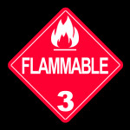


Combustion Reactions
In general:
C_{x}H_{y} + O₂ → CO₂ + H₂O
Products in combustion are ALWAYS carbon dioxide and water. (although incomplete burning does cause some by-products like carbon monoxide)
Combustion is used to heat homes and run automobiles (octane, as in gasoline, is C₈H₁₈)

Slide 124
Review: Chemical Equations
Chemical change involves a reorganization of
the atoms in one or more substances.
C₂H₅OH + 3O₂ → 2CO₂ + 3H₂O
reactants
products
When the equation is balanced it has quantitative significance:
1 mole of ethanol reacts with 3 moles of oxygen
to produce
2 moles of carbon dioxide and 3 moles of water

Slide 125
Working a Stoichiometry Problem gram A to gram B
100.0 grams of aluminum reacts with an excess of oxygen. How many grams of aluminum oxide are formed?
4 Al + 3 O₂ → 2Al₂O₃
100.0 g Al
1 mol Al
2 mol Al₂O₃
101.96 g Al₂O₃
=
? g Al₂O₃
26.98 g Al
4 mol Al
1 mol Al₂O₃
189.0 g Al₂O₃

Slide 126

Limiting Reactant or Reagent
The limiting reactant is the reactant that is consumed first, limiting the amounts of products formed.
Tend to be: expensive, rare, or toxic reagent

Slide 127
Excess Reagent
The more abundant reactant. Does not run out at the end of the experiment. If a chemist has a choice it will
Tend to be cheaper,
abundant,
non-toxic
Methane combusts to give a lot of heat and energy.
What reagent do you think a chemist would hold as the limiting reagent? Why?

Slide 128
Determine the Limiting Reagent
Compare the amount each reagent can produce the one that produces the least is the limiting reagent. For the problem below solve 2 gram to gram problems and evaluate: 4 Al + 3 O₂ → 2Al₂O₃
Given 50.00 grams of aluminum and 50.00 grams of oxygen what is the maximum mass of aluminum oxide that may be produced? What is the limiting reagent?
1mol Al 2 Al₂O₃ 101.96 g
50.0 g Al 27.0 grams 4 Al 1moles Al₂O₃ = 94.4 g Al₂O₃
1mol O₂ 2 Al₂O₃ 101.96 g
50.0g O₂ 32.0 grams 3 O₂ 1moles Al₂O₃ = 106. g Al₂O₃
Therefore only 94.4 grams can be made!
How much oxygen remains?

Slide 129
Determine the leftover amount of excess reagent
Subtract what was produced from what could have been produced and send backwards:
4 Al + 3 O₂ → 2Al₂O₃
106.0 grams- 94.4 grams = 11.6 grams
11.6 g 1mol Al₂O₃ 3 O₂ 32.0g O₂
101.96 grams 2 Al₂O₃ 1 mole Al =
5.46 grams of Oxygen leftover

Slide 130

Percent Yield
Find the theoretical amount or (Mathematical result )
Divide what was obtained (Lab or Actual) by the theoretical
Multiply by 100
Yields are seldom 100% due to four factors:
Poor Collection,
Impure reagents,
Incomplete reactions,
and Competing side reactions

Slide 131
Percent Yield
Cindy reacts 4.00 grams of aluminum with an excess of oxygen and formed 7.05 grams of aluminum oxide. Please calculate her percent yield.
Calc Theo:
4.00 g Al 1mol Al 2 Al₂O₃ 101.96 g
27.0 g 4 Al 1 molAl₂O₃
Should get: 7.55 grams Al₂O₃
% Yield = 7.05 / 7.55 x 100 = 93.4%

Slide 132
Kinetic Molecular Theory
Particles of matter are ALWAYS in motion
Volume of individual particles is ≈ zero. Consists of large number of particles that are very far apart
Collisions of particles with container walls cause pressure exerted by gas but are negated
Particles exert no forces on each other
( neither attraction or repulsion)
Average kinetic energy ∝ Kelvin temperature of a gas. ( the warmer the faster)

Slide 133
The Meaning of Temperature
Kelvin temperature is an index of the random motions of gas particles
(higher T means greater motion.)

Slide 134
The Nature of Gases
Expansion: Gases expand to fill their containers completely
Fluidity: – they flow and slide past one another
Gases have low density
  1/1000 the density of the equivalent liquid or solid
Compressibility: can move molecules closer together
Diffusion: Spontaneous mixing of molecules
Depends on size, shape, force of attraction & temperature
effusion: forced through a tiny opening

Slide 135
Kinetic Energy of Gas Particles
At the same conditions of temperature, all gases have the same average kinetic energy. Therefore at the same temperature lighter gases are moving FASTER
m = mass
v = velocity

Slide 136

Measuring Pressure
The first device for measuring atmospheric
pressure was developed by Evangelista Torricelli
during the 17th century.
The device was called a “barometer”
Baro = weight
Meter = measure

Slide 137
Standard Temperature & Pressure
“STP”
P = 1 atmosphere (atm),
760 torr
101.3 kPa
760 mmHg
T = 0°C, 273 Kelvins

Slide 138
Boyle’s Law
The volume of a fixed mass of gas varies inversely with the pressure at a constant temperature ( pressure and volume under both conditions must have the same units)
Think of a piston in a plunger: it is harder to push the plunger down at the end of the stroke where volume has decreased)

Slide 139
Mathematical Computation Boyles Law # 1:
A fixed sample of oxygen exerted a pressure of 789 mmHg in a 325 ml vessel. Providing the temperature remains constant, if the gas is transferred to a 275ml vessel what pressure would the gas exert in the new vessel in atm?

Slide 140
Converting Celsius to Kelvin
Gas law problems involving temperature require that the temperature be in KELVINS!
Kelvins = °C + 273.15
°C = Kelvins – 273.15

Slide 141
Charles’s Law
The volume of a gas at constant pressure is directly proportional to Kelvin temperature, and extrapolates to zero at zero Kelvin.
    (P = constant)
Think about an inflated balloon in a warm home. You step out into the cold night air. What happens?
Temperature MUST be in KELVINS!

Slide 142
Mathematical Computation : Charles Law #1
A sample of neon in a balloon at constant pressure has a volume of 725.ml at 22.0⁰c. If the balloon is left in a car where the volume expeands to 800.00 ml, what temperature in 0c is the interior of the car assuming the pressure remains constant?

Slide 143
Gay Lussac’s Law
The pressure and Kelvin temperature of a gas
are directly related, provided that the volume
remains constant.
Think about when you have a fixed space and increase the temp, molecules will increase movement which increases collisions which is pressure (and vice versa)!
Temperature MUST be in KELVINS!

Slide 144
Mathematical Computation: Gay-Lussacs Law#1
Before a car ride the pressure in an automobile tire was measured with a pressure gauge to be 1370 mmHg at a temperature of 20.0⁰c. At the end of a road trip the pressure was found to be 1.90 atm. Assuming the volume of the tires did not change, what is the temperature of gas inside the tire in Celsius?

Slide 145
The Combined Gas Law
The combined gas law expresses the relationship between pressure, volume and temperature of a fixed amount of gas.
Boyle’s law, Gay-Lussac’s law, and Charles’ law are all derived from this by holding a variable constant. Again temperature must be in Kelvins and units must match!

Slide 146
Mathematical Computation: Combined Gas Law #1
A sample of oxygen gas occupies a volume of 0.250 liters at 22.0⁰c and exerts a pressure of 750.0 mmHg. What volume will the gas occupy if the temperature drops to 5.0⁰c and the pressure decreased to 0.950 atm?

Slide 147
Ideal Gases
Ideal gases are imaginary gases that perfectly fit all of the assumptions of the kinetic molecular theory.
Gases consist of tiny particles that are far apart
relative to their size.
Collisions between gas particles and between
particles and the walls of the container are
elastic collisions
No kinetic energy is lost in elastic
collisions

Slide 148
Ideal Gases (continued)
Gas particles are in constant, rapid motion. They
therefore possess kinetic energy, the energy of
motion
There are no forces of attraction between gas
particles
The average kinetic energy of gas particles
depends on temperature, not on the identity
of the particle.

Slide 149
Real Gases Do Not Behave Ideally
Real gases DO experience inter-molecular attractions
Real gases DO have volume
Real gases DO NOT have elastic collisions

Slide 150
Deviations from Ideal Behavior
Likely to behave nearly ideally
Conditions: Gases at high temperature and low pressure
Charateristics: Small symmetrical non-polar gas molecules
Likely not to behave ideally
Conditions: Gases at low temperature and high pressure
Characteristics Large, non-symmetrical polar gas molecules

Slide 151

The conditions 0 ⁰C and 1 atm are called standard temperature and pressure (STP).
Experiments show that at STP, 1 mole of an ideal gas occupies 22.414 L.
PV = nRT
PV
(1 atm)(22.414L)
R =
=
nT
(1 mol)(273.15 K)
R = 0.082057 L • atm / (mol • K)

Slide 152
What is the volume (in liters) occupied by 49.8 g of HCl at STP?
T = 0 ⁰C = 273.15 K
P = 1 atm
PV = nRT
1 mol HCl
nRT
n = 49.8 g x
= 1.37 mol
V =
36.45 g HCl
P
L•atm
1.37 mol x 0.0821 x 273.15 K
mol•K
V =
1 atm
V = 30.6 L

Slide 153
Ideal Gas Equation
1
Boyle’s law: V α (at constant n and T)
P
Charles’ law: V α T (at constant n and P)
Avogadro’s law: V α n (at constant P and T)
nT
V α
P
nT
nT
V = constant x = R
R is the gas constant
P
P
PV = nRT

Slide 154
Determine Pressure:
Determine the pressure in atm exerted by 12.0 grams of sulfur dioxide gas at 22. ⁰ C in a 750.0 ml vessel.
Change all units:
n SO₂ = 12.0 grams of SO₂ 1 mole SO₂ = 0.188 moles SO₂
64.0 g
T= 22 + 273 = 295 K
V= 0.750 L
2. Plug into equation
6.07 atm

Slide 155
Determine Volume:
Determine the volume occupied by 5.00 grams of sulfur dioxide at 10.⁰C exerting a pressure of 12.5 Kpa.
Change all units:
n SO₂ = 5.00 grams of SO₂ 1 mole SO₂ = 0.0781 moles SO₂
64.0 g
T= 10. + 273 = 285 K
P = 12.5 1 atm = 0.123 atm
101.3KPa
2. Plug into equation
14.8 L

Slide 156
Gas Stoichiometry #1
If reactants and products are at the same conditions of temperature and pressure, then mole ratios of gases are also volume ratios.
3 H₂(g) + N₂(g) → 2NH₃(g)
3 moles H₂ + 1 mole N₂ → 2 moles NH₃
3 liters H₂ + 1 liter N₂ → 2 liters NH₃

Slide 157
Gas Stoichiometry #2
How many liters of ammonia can be produced when 12 liters of hydrogen react with an excess of nitrogen?
3 H₂(g) + N₂(g) → 2NH₃(g)
12 L H₂
2
L NH₃
= L NH₃
8.0
3
L H₂

Slide 158
Gas Stoichiometry #3 At STP
How many liters of oxygen gas, at STP, can be collected from the complete decomposition of 50.0 grams of potassium chlorate?
2 KClO₃(s) → 2 KCl(s) + 3 O₂(g)
50.0 g KClO₃
1 mol KClO₃
3 mol O₂
22.4 L O₂
122.55 g KClO₃
2 mol KClO₃
1 mol O₂
= 13.7 L O₂

Slide 159
Gas Stoichiometry #4
How many liters of oxygen gas, at 37.0°C and 0.930 atmospheres, can be collected from the complete decomposition of 50.0 grams of potassium chlorate?
2 KClO₃(s) → 2 KCl(s) + 3 O₂(g)
50.0 g KClO₃
1 mol KClO₃
3 mol O₂
0.612
=
mol O₂
122.55 g KClO₃
2 mol KClO₃
= 16.7 L

Slide 160
Solute
Parts of a Solution Review
A solute is the dissolved substance in a solution.
Salt in salt water
Sugar in soda drinks
Carbon dioxide in soda drinks
Solvent
A solvent is the dissolving medium in a solution.
Water in salt water
Water in soda

Slide 161

Dissolution of sodium Chloride
This Process is called solvation-
if the solvent is water it is called hydration

Slide 162
General Terms (qualitative) to describe how much solute is dissolved in the solvent
Dilute- a little solute per solvent
Concentrated- a lot of solute per solvent
Sometimes color of the solution can help- the lighter color more dilute the darker color the more concentrated

Slide 163
SOLUBILTY
The solubility of a substance is the amount of solute that dissolves in a given quantity of a solvent at a specified temperature and pressure to produce a saturated solution.
Solubility is often expressed in grams of solute per 100 g of solvent.
Solubility of NaCl in water @25ºC: 36.2g/100g

Slide 164

Electrolytes vs. Nonelectrolytes
The ammeter measures the flow of electrons (current)
through the circuit.
If the ammeter measures a current, and the bulb
glows, then the solution conducts.
If the ammeter fails to measure a current, and the
bulb does not glow, the solution is non-conducting.

Slide 165
Definition of Electrolytes and Nonelectrolytes
An electrolyte is:
A substance whose aqueous solution conducts
an electric current.
A nonelectrolyte is:
A substance whose aqueous solution does not
conduct an electric current.
Try to classify the following substances as
electrolytes or nonelectrolytes…

Slide 166
Factors Effecting Solubility
The solubility of MOST solids increases with temperature. *(more collisions)
The rate at which solids dissolve increases with increasing surface area of the solid.*(more solvent solute interaction)
The rate of dissolving a solid into a liquid increases when agitated *(fresh solvent to solute)
The solubility of gases decreases with increases in temperature. (MOVEMENT SPEEDS UP ESCAPE IS EASIER)
The solubility of gases increases with the pressure above the solution.( KEEPS GASES INSIDE THE LIQUID PHASE)

Slide 167
Therefore…
Solids tend to dissolve best when:
Heated -Kinetic energy is higher collisions occur more often between solute and solvent
Stirred- brings fresh solvent to solute
Ground into small particles- more surface area for solvent solute interactions

Slide 168
Gas in a Liquid tend to dissolve best when:
The solution is cold- slows molecules down don’t escape as fast
Pressure is high- keeps molecules in solution

Slide 169
Saturation of Solutions
A solution that conta ins less solute than a saturated solution under existing conditions is unsaturated.
A solution that contains the maximum amount of solute that may be dissolved under existing conditions is saturated.
A solution that contains more dissolved solute than a saturated solution under the same conditions is supersaturated.

Slide 170
1. Molarity (M)= moles (of solute) liter (of solvent)
What is the molarity of a solution when 56.9 grams of calcium chloride are dissolved in 750.0 ml of water?
56.9 grams 1 mol CaCl₂ 1 =
111.1 grams 0.750 l
0.683 Molar

Slide 171
To find solute give concentration:
1. How many grams of sodium chloride are needed to make a 0.500 M solution in a 750 ml vessel?
0.500 M 0.750 L 58.5 g =
1 1 mol
21.9 grams

Slide 172
Molarity Of IONS (M)= moles ions liter (of solvent)
What is the molarity of chloride ions in solution when 56.9 grams of calcium chloride are dissolved in 750.0 ml of water?
56.9 grams 1 mol CaCl₂ 1 2 Cl⁻¹ =
111.1 grams 0.750 l 1 CaCl₂
1.37 Molar Cl⁻¹

Slide 173
To find solute given concentration of ions needed:
1. How many grams of magnesium chloride are needed to make a 0.500 M chloride ion solution in a 750 ml vessel?
0.500 M Cl⁻¹ 1 mol MgCl₂ 95.2g 0.750 L =
2 Mol Cl⁻¹ 1 mol MgCl₂ 1
17.8 grams of solute

Slide 174
3. Dilution
Preparation of a desired solution by adding water to a concentrate.
Moles of solute remain the same.

Slide 175
C. Dilution
What volume of 15.8M HNO₃ is required to make 250 mL of a 6.0M solution?
WORK:
M₁ V₁ = M₂ V₂
(15.8M) V₁ = (6.0M)(250mL)
V₁ = 95 mL of 15.8M HNO₃
GIVEN:
M₁ = 15.8M
V₁ = ?
M₂ = 6.0M
V₂ = 250 mL

Slide 176


D. Preparing Solutions
250 mL of 6.0M HNO₃
by dilution given a stock of 15.8 M
  measure 95 mL
  of 15.8M HNO₃
95 mL of
15.8M HNO₃
  combine with water until total volume is 250 mL
250 mL mark
  Safety: “Do as you oughtta, add the acid to the watta!”
water for safety

Slide 177
Calculations of Solution Concentration
Concentration - A measure of the amount of
solute in a given amount of solvent or solution
Grams per liter - the mass of solute divided by the volume of solution, in liters
Molarity - moles of solute divided by the volume of solution in liters
Parts per million – the ratio of parts (mass) of solute to one million parts (mass) of solution
Percent composition - the ratio of one part of solute to one hundred parts of solution, expressed as a percent

Slide 178
Properties of Acids
Acids taste sour
Acids effect indicators
    Blue litmus turns red
    Methyl orange turns red
Acids have a pH lower than 7
Acids are proton (hydrogen ion, H⁺) donors
Acids react with active metals, produce H₂
Acids react with carbonates to release
carbon dioxide and water
Acids neutralize bases to form salt and
water
Acids are sticky
Acids are electrolytes

Slide 179

Sulfuric Acid H₂SO₄
Highest volume production of any chemical in the U.S. ( can judge the industrialization by consumption)
Used in the production of paper
Used in production of fertilizers
Used in petroleum refining
Thick clouds of sulfuric acid are a feature of the atmosphere of Venus.
(image provided by NASA)

Slide 180
Acids are Proton Donors-
More hydrogens doesn’t mean stronger!!!!
Monoprotic acids
Diprotic acids
Triprotic acids
HCl
H₂SO₄
H₃PO₄
HC₂H₃O₂
H₂CO₃
HNO₃

Slide 181
DANGER DANGER diluting acid
(AAA) ALWAYS ADD ACID
If you add water to ACID you have lot of acid little water you can have major reaction occur with splattering no one wants acid in the face

Slide 182
Concentration in Terms of NORMALITY
Normality = M x # of equivalences
Eq uivalences are the number of hydrogens (for acids) or hydroxides (for bases)
What is the normality of a 3.0 M H₂SO₄ solution?

Slide 183

Organic Acids
Organic acids all contain the “carboxyl” group, sometimes several of them.
The carboxyl group is a poor proton donor, so ALL organic acids are weak acids.

Slide 184
Examples of Organic Acids
Citric acid in citrus fruit
Malic acid in sour apples
Deoxyribonucleic acid, DNA
Amino acids, the building blocks of protein
Lactic acid in sour milk and sore muscles
Butyric acid in rancid butter

Slide 185
Strong Acids vs. Weak Acids
Strong acids are assumed to be 100% ionized in solution (good proton donors).
HCl
H₂SO₄
HNO₃
Weak acids are usually less than 5% ionized in solution (poor proton donors).
H₃PO₄
HC₂H₃O₂
Organic acids

Slide 186

The pH Concept
The pH of a solution is the negative logarithm of the hydrogen-ion concentration.

Slide 187

Acids Have a pH less than 7

Slide 188


Measuring pH
Universal Indicators change color over the entire pH scale.
Notes:
You can find acidic and basic substances in your home. a) Universal indicator solution has been added to solutions of known pH in the range from 1 to 12 to produce a set of reference colors. b) Universal indicator has been added to samples of vinegar, soda water, and ammonia solution. Interpreting Photographs Use the reference colors to assign pH values to vinegar, soda water, and ammonia solution.

Slide 189

Hydrogen Ions from Water
The reaction in which water molecules produce ions is called the self-ionization of water.
The self-ionization of water occurs to a VERY small extent.
Note the hydrogen ion will pick up a water molecule forming hydronium ion H₃O⁺

Slide 190
The pH Concept
A solution in which [H⁺] is greater than 1 × 10^{–7} M has a pH less than 7.0 and is acidic.
The pH of pure water or a neutral aqueous solution is 7.0 and has a [H⁺] equal to 1 × 10^{–7} M.
A solution with a pH greater than 7 is basic and has a [H⁺] of less than 1 × 10^{–7} M.

Slide 191
Acids Neutralize Bases
Neutralization reactions ALWAYS produce a salt and water.
HCl + NaOH → NaCl + H₂O
H₂SO₄ + 2NaOH → Na₂SO₄ + 2H₂O
2HNO₃ + Mg(OH)₂ → Mg(NO₃)₂ + 2H₂O

Slide 192

BASES
19.1
Bracken Cave, near San Antonio, Texas, is home to twenty to forty million bats.
Visitors to the cave must protect themselves from the dangerous levels of ammonia in the cave.
Ammonia is a byproduct of the bats’ urine.
You will learn why ammonia is considered a base.

Slide 193
Properties of Bases
Bases taste bitter
Bases effect indicators
    Red litmus turns blue
    Phenolphthalein turns magenta
    Bases have a pH greater than 7
Bases are proton (hydrogen ion, H⁺) acceptors
Hydroxide donors (OH⁻¹)
Solutions of bases feel slippery
Bases are electrolytes
Bases neutralize acids
Bases emulsify fats and oils- SOAP

Slide 194

Examples of Bases
Sodium hydroxide (lye), NaOH
Draino
Potassium hydroxide, KOH
Magnesium hydroxide, Mg(OH)₂
Calcium hydroxide (lime), Ca(OH)₂
_{TUMS}
AND AMMONIA NH_{3 !}

Slide 195

Titration
The concentration of an acid and base can be determined performed a neutralization reaction called a titration.
The process of adding a known amount of solution of known concentration to determine the concentration of another solution is called titration.

Slide 196
To perform a titration:
Measure out a known volume of the acid solution of unknown concentration into an erlenmeyer flask.
Add a few drops of indicator. (For acid-base titrations, use phenolphthalein.)
Use a buret to add a base until the indicator changes color. (Phenolphthalein will change from clear to pink.)
Plot or perform calculation (N_{A}V_{A}= N_{B}V_{B})

Slide 197
Titration
The solution of known concentration is the standard solution.
The point when the indicator changes color is the end point of the titration.
The equivalence point is when the number of moles of hydrogen ions equals the number of moles of hydroxide ions.
  This happens right before the end point.

Slide 198



Titration
Acid solution with indicator
Added base is measured with a buret.
Color change shows neutralization.
Notes:
The titration of an acid with a base is shown here. a) A known volume of an acid (plus a few drops of phenolphthalein indicator) in a flask is placed beneath a buret filled with a base of known concentration. b) Base is slowly added from the buret to the acid while the flask is gently swirled. c) A change in the color of the indicator signals that neutralization has occurred.

Slide 199

Titration- a plot of volume added and pH helps determine the equivalence point
Notes:
In this titration of a strong acid with a strong base, 0.10M NaOH is slowly added from a buret to 50.0 mL of 0.10M HCl in the beaker. The equivalence point, the midpoint on the vertical portion of the pH titration curve, occurs at 50.0 mL of NaOH added. Interpreting Diagrams What is true concerning [H⁺] and [OH⁻] at the equivalence point?

Slide 200
Strong Acid/Strong Base Titration
Endpoint is at
pH 7
A solution that is
0.10 M HCl is titrated with
0.10 M NaOH

Slide 201

Titration calculation
25.00 mls of a 0.25 M HCl solution are needed to completely neutralize 50.00 mls of an unknown sodium hydroxide solution.
What is the concentration of the base?

