Slide 1
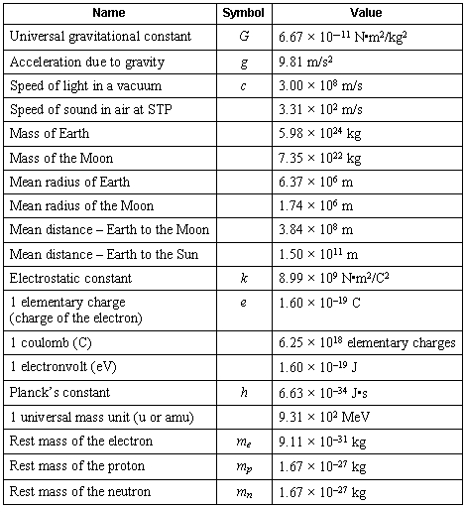
Scientific Notation

Slide 2
Scientific Notation
In science, we deal with some very LARGE numbers:
1 mole = 602000000000000000000000
In science, we deal with some very SMALL numbers:
Mass of an electron =
0.000000000000000000000000000000091 kg

Slide 3
Imagine the difficulty of calculating the mass of 1 mole of electrons!
0.000000000000000000000000000000091 kg
x 602000000000000000000000
???????????????????????????????????

Slide 4
Scientific Notation:
A method of representing very large or very small numbers in the form:
M x 10^{n}
M is a number between 1 and 10
n is an integer

Slide 5
.
2 500 000 000
9
8
7
6
5
4
3
2
1
Step #1: Insert an understood decimal point
Step #2: Decide where the decimal must end
up so that one number is to its left
Step #3: Count how many places you bounce
the decimal point
Step #4: Re-write in the form M x 10^{n}

Slide 6
2.5 x 10⁹
The exponent is the number of places we moved the decimal.

Slide 7
0.0000579
1
2
3
4
5
Step #2: Decide where the decimal must end
up so that one number is to its left
Step #3: Count how many places you bounce
the decimal point
Step #4: Re-write in the form M x 10^{n}

Slide 8
5.79 x 10⁻⁵
The exponent is negative because the number we started with was less than 1.

Slide 9
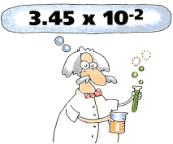
PERFORMING CALCULATIONS IN SCIENTIFIC NOTATION
ADDITION AND SUBTRACTION

Slide 10
Review:
Scientific notation expresses a number in the form:
M x 10^{n}
n is an integer
1 ≤ M < 10

Slide 11
4 x 10⁶
IF the exponents are the same, we simply add or subtract the numbers in front and bring the exponent down unchanged.
+ 3 x 10⁶
7
x 10⁶

Slide 12
The same holds true for subtraction in scientific notation.
4 x 10⁶
- 3 x 10⁶
1
x 10⁶

Slide 13
4 x 10⁶
If the exponents are NOT the same, we must move a decimal to make them the same.
+ 3 x 10⁵

Slide 14
4.00 x 10⁶
4.00 x 10⁶
+ 3.00 x 10⁵
+ .30 x 10⁶
4.30
x 10⁶
Move the decimal on the smaller number!

Slide 15
A Problem for you…
2.37 x 10⁻⁶
+ 3.48 x 10⁻⁴

Slide 16
Solution…
002.37 x 10⁻⁶
2.37 x 10⁻⁶
+ 3.48 x 10⁻⁴

Slide 17
Solution…
0.0237 x 10⁻⁴
+ 3.48 x 10⁻⁴
3.5037 x 10⁻⁴

Slide 18
PERFORMING CALCULATIONS IN SCIENTIFIC NOTATION
Multiplication and Division

Slide 19
Multiplication and Division
Multiplication: You simply multiply the coefficients and then add the exponents
(4.0 x 10⁶ ) (2.0 x 10⁵ )= 8.0 x 10¹¹
Division: You simply divide the coefficients and the subtract the exponents.
(4.0 x 10⁷ ) / (2.0 x 10⁵ )= 2.0 x 10²

Slide 20
Using a calculator with Scientific Notation
4.0 x 10⁶
x 3.0 x 10⁸
1. Find your EE or EXP button on your calculator!!
1.2
x 10¹⁵
2. Plug in 4.0 HIT EE/EXP then the exponent 6 (DO NOT PLUG IN THE X 10!!!)
3. Do the multiplication operation
4. Plug in 3.0 hit EE/Exp then the exponent 8
5. Then Equals VIOLA!!!

