Slide 1
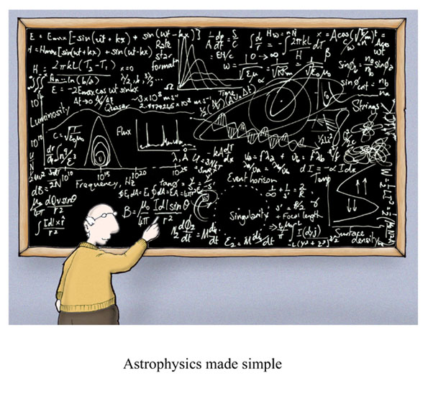
Uncertainty and Significant Figures
Cartoon courtesy of Lab-initio.com

Slide 2
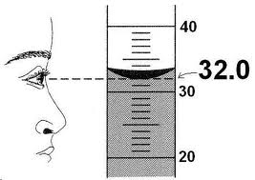
Uncertainty in Measurement
A digit that must be estimated is called uncertain. A measurement always has some degree of uncertainty.

Slide 3
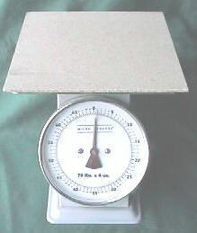
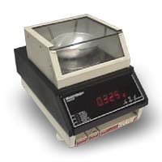
Why Is there Uncertainty?
Measurements are performed with instruments
No instrument can read to an infinite number of decimal places
Which of these balances has the greatest uncertainty in measurement?

Slide 4
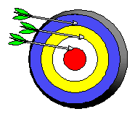
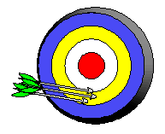
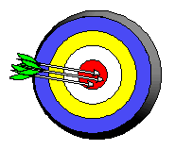
Precision and Accuracy
Accuracy refers to the agreement of a particular value with the true value.
Precision refers to the degree of agreement among several measurements made in the same manner.
Neither accurate nor precise
Precise but not accurate
Precise AND accurate

Slide 5
Types of Error
Random Error (Indeterminate Error) - measurement has an equal probability of being high or low.
Systematic Error (Determinate Error) - Occurs in the same direction each time (high or low), often resulting from poor technique or incorrect calibration.

Slide 6
Percent Error
Percent error: is calculated by subtracting the experimental value from the accepted value, then dividing the difference from the accepted value, and multiplying by 100.
Percent error ₌ Value_{accepted}-Value_{experimental X 100}
Value_{accepted}

Slide 7
Example #1
Example 1. What is the percent error for a mass measurement of 17.7g, given that the correct value is 21.2g?
Percent error ₌ Value_{accepted}-Value_{experimental X 100}
Value_{accepted}
Percent error ₌ 21.2g-17.7g _{X 100}
_{21.2g}
_{Percent error = 16.5%}

Slide 8
Rules for Counting Significant Figures - Details
Nonzero integers always count as significant figures.
3456 has
4 significant figures

Slide 9
Rules for Counting Significant Figures - Details
Zeros
- Leading zeros do not count as
significant figures.
0.0486 has
3 significant figures

Slide 10
Rules for Counting Significant Figures - Details
Zeros
- Captive zeros always count as
significant figures.
16.07 has
4 significant figures

Slide 11
Rules for Counting Significant Figures - Details
Zeros
Trailing zeros are significant only if the number contains a decimal point.
9.300 has
4 significant figures

Slide 12
Rules for Counting Significant Figures - Details
Exact numbers have an infinite number of significant figures.
1 inch = 2.54 cm, exactly
Scientific Notation - all of the numbers on front of the x10 are significant.
6.022x10²³ = 4 significant figures.

Slide 13
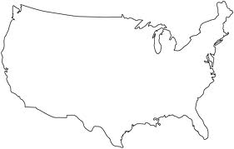
Identifying & Counting Significant Figures:
Use the Atlantic-Pacific Rule! If the decimal point is absent approach the number from the Atlantic side, go to your first non-zero number, and count all the way through. If the decimal point is present approach the number from the Pacific side go to your first non-zero number, and count all the way through.
Pacific Ocean
Atlantic Ocean

Slide 14
Sig Fig Practice #1
How many significant figures in each of the following?
1.0070 m →
5 sig figs
17.10 kg →
4 sig figs
100,890 L →
5 sig figs
3.29 x 10³ s →
3 sig figs
0.0054 cm →
2 sig figs
3,200,000 →
2 sig figs

Slide 15
Rules for Significant Figures in Mathematical Operations
Multiplication and Division: # sig figs in the result equals the number in the least precise measurement used in the calculation.
6.38 x 2.0 =
12.76 →
13 (2 sig figs)

Slide 16
Sig Fig Practice #2
Calculation
Calculator says:
Answer
3.24 m x 7.0 m
22.68 m²
23 m²
100.0 g ÷ 23.7 cm³
4.219409283 g/cm³
4.22 g/cm³
0.02 cm x 2.371 cm
0.04742 cm²
0.05 cm²
710 m ÷ 3.0 s
236.6666667 m/s
240 m/s
1818.2 lb x 3.23 ft
5872.786 lb·ft
5870 lb·ft
1.030 g ÷ 2.87 mL
2.9561 g/mL
2.96 g/mL

Slide 17
Rules for Significant Figures in Mathematical Operations
Addition and Subtraction: The number of decimal places in the result equals the number of decimal places in the least precise measurement.
6.8 + 11.934 =
18.734 →
18.7 (tenths place)

Slide 18
Sig Fig Practice #3
Calculation
Calculator says:
Answer
3.24 m + 7.0 m
10.24 m
10.2 m
100.0 g - 23.73 g
76.27 g
76.3 g
0.02 cm + 2.371 cm
2.391 cm
2.39 cm
713.1 L - 3.872 L
709.228 L
709.2 L
1818.2 lb + 3.37 lb
1821.57 lb
1821.6 lb
2.030 mL - 1.870 mL
0.16 mL
0.160 mL

